Slide 1
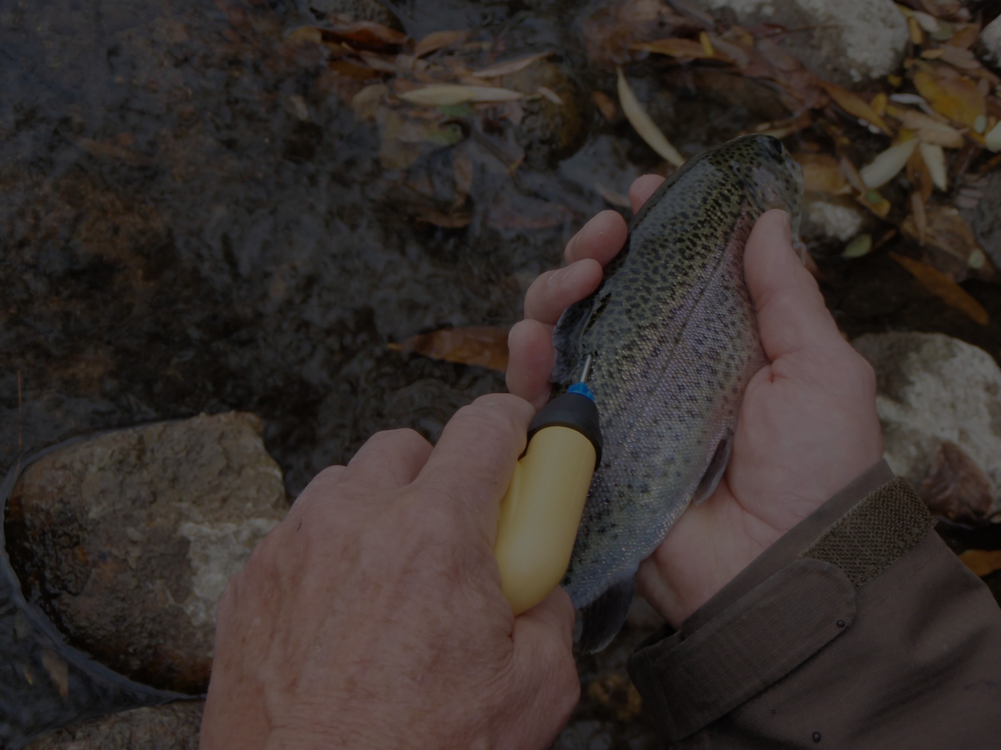

How Many Fish Are There?
IDFG mark-recapture from screw traps to Lower Granite Dam
Dave Smith
Idaho Department of Fish and Game, Nampa Research
PIT tagged
upstream
Screw trap
recaptures
Lower Granite
GRJ and GRS
Little Goose
GOJ
Notes:
Opening line: everything today is about getting one number right at Lower Granite Dam.
The path along the bottom is the talk: a fish gets a PIT tag upstream, may be recaptured at a screw trap, passes Lower Granite (seen in the bypass at GRJ or on the spillway antennas at GRS, or not at all), and may be seen again at Little Goose (GOJ).
Check before presenting: photo credit and permission for the title photo; talk length (built for a 50-minute slot).

Slide 2
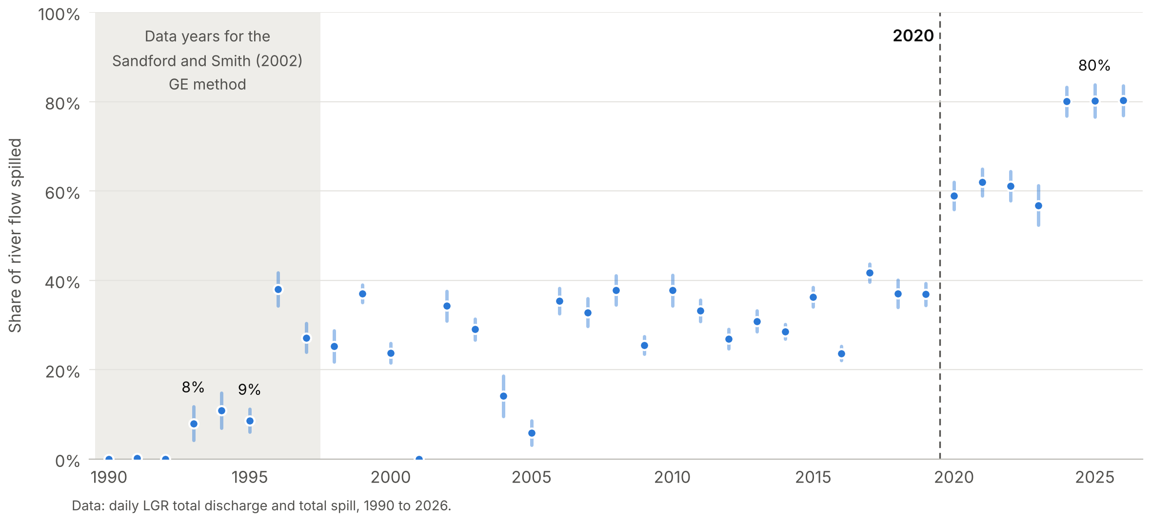
The System Changed
THE PROBLEM
80%
mean daily share of April to May flow spilled at LGR in 2024 to 2026, up from 8 to 9% in 1993 and 1995
70%
wild steelhead GE at LGR in low-spill 1993 and 1995, the era SCRAPI's GE comes from
April 1 to May 31 each year. Dot: mean daily share of flow spilled. Bar: 95% CI of the mean (61 days).
13% vs 5%
GE too high means abundance too low.
The MY2023 report: Sandford and Smith “could be substantially overestimating guidance efficiencies during higher spill, resulting in underestimations of abundance.”
MY2025 wild steelhead, high-spill weeks: NOAA GE vs season GE from PIT counts (0.048)
Notes:
Say: everything today is about getting one number right.
The 2020 Record of Decision raised spill at Lower Granite (LGR) to a higher share of total flow than before (Beeken et al. 2025). Mean daily share of April to May LGR flow spilled: 8.0% in 1993 and 8.6% in 1995, 36.9% in 2019, about 57 to 62% in 2020 to 2023, and 80% in 2024 to 2026. Bars are 95% CIs of the mean over 61 days; days are autocorrelated, so treat them as optimistic.
SCRAPI's guidance efficiency (GE) comes from NOAA via Sandford and Smith (2002), built on 1990 to 1997 data. In the low-spill years 1993 and 1995, LGR detection (bypass only then, so effectively GE) averaged 70% for wild steelhead.
MY2025 wild steelhead: NOAA GE sat near 13% through the high-spill weeks. Closed-form season GE straight from PIT counts: 0.048.
GE too high means abundance too low. The MY2023 report says it directly.
Figure: built from the daily LGR flow and spill file.

Slide 3
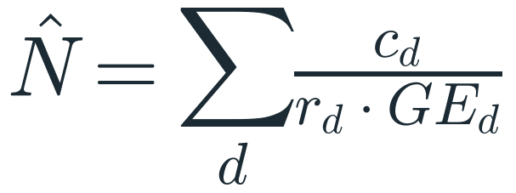
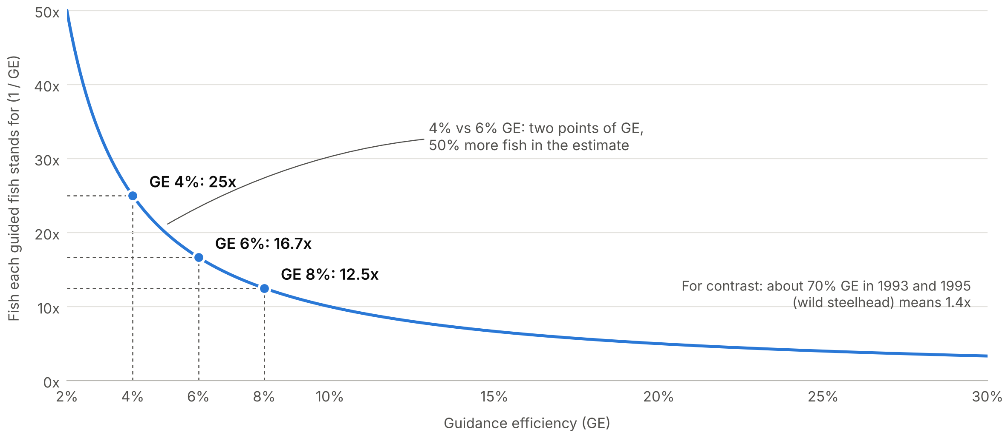
Why One Number Matters So Much
THE PROBLEM
c = trap catch, r = sample rate,
GE = guidance efficiency, d = day
4% vs 6% GE
is 25× vs 16.7× expansion: two points of GE, a 50% difference in abundance.
MY2021 wild steelhead, published 294,392
GE up 25%: about 238k
GE down 25%: about 400k
SCRAPI expands each guided fish by 1 / GE. Wild steelhead season GE was 3.7 to 4.8% in MY2021, 2024, and 2025.
How do we estimate GE better? With PIT tags.
Fish tagged upstream are detected passing LGR and again downstream. That is mark-recapture data.
Notes:
SCRAPI's estimate: N-hat = sum over days of catch / (sample rate x GE).
The expansion is 1/GE: GE 8% gives 12.5x, 6% gives 16.7x, 4% gives 25x. Two points of GE (4% vs 6%) is a 50% difference in abundance.
Real example, MY2021 (Ebel to Baum email, Nov 2022): raising GE 25% gave about 238k; lowering it 25% gave about 400k. These fit steelhead: the published MY2021 wild steelhead estimate was 294,392, and 294k / 1.25 is about 235k, 294k / 0.75 about 393k. Wild Chinook was 160,082, which doesn't fit.
Close with the question the rest of the talk answers: how do we estimate GE better? With PIT tags. Fish tagged upstream are detected as they pass LGR and again downstream, and that is mark-recapture data.
Say: before LGR, let's see how PIT-tag mark-recapture works where we control everything.

Slide 4
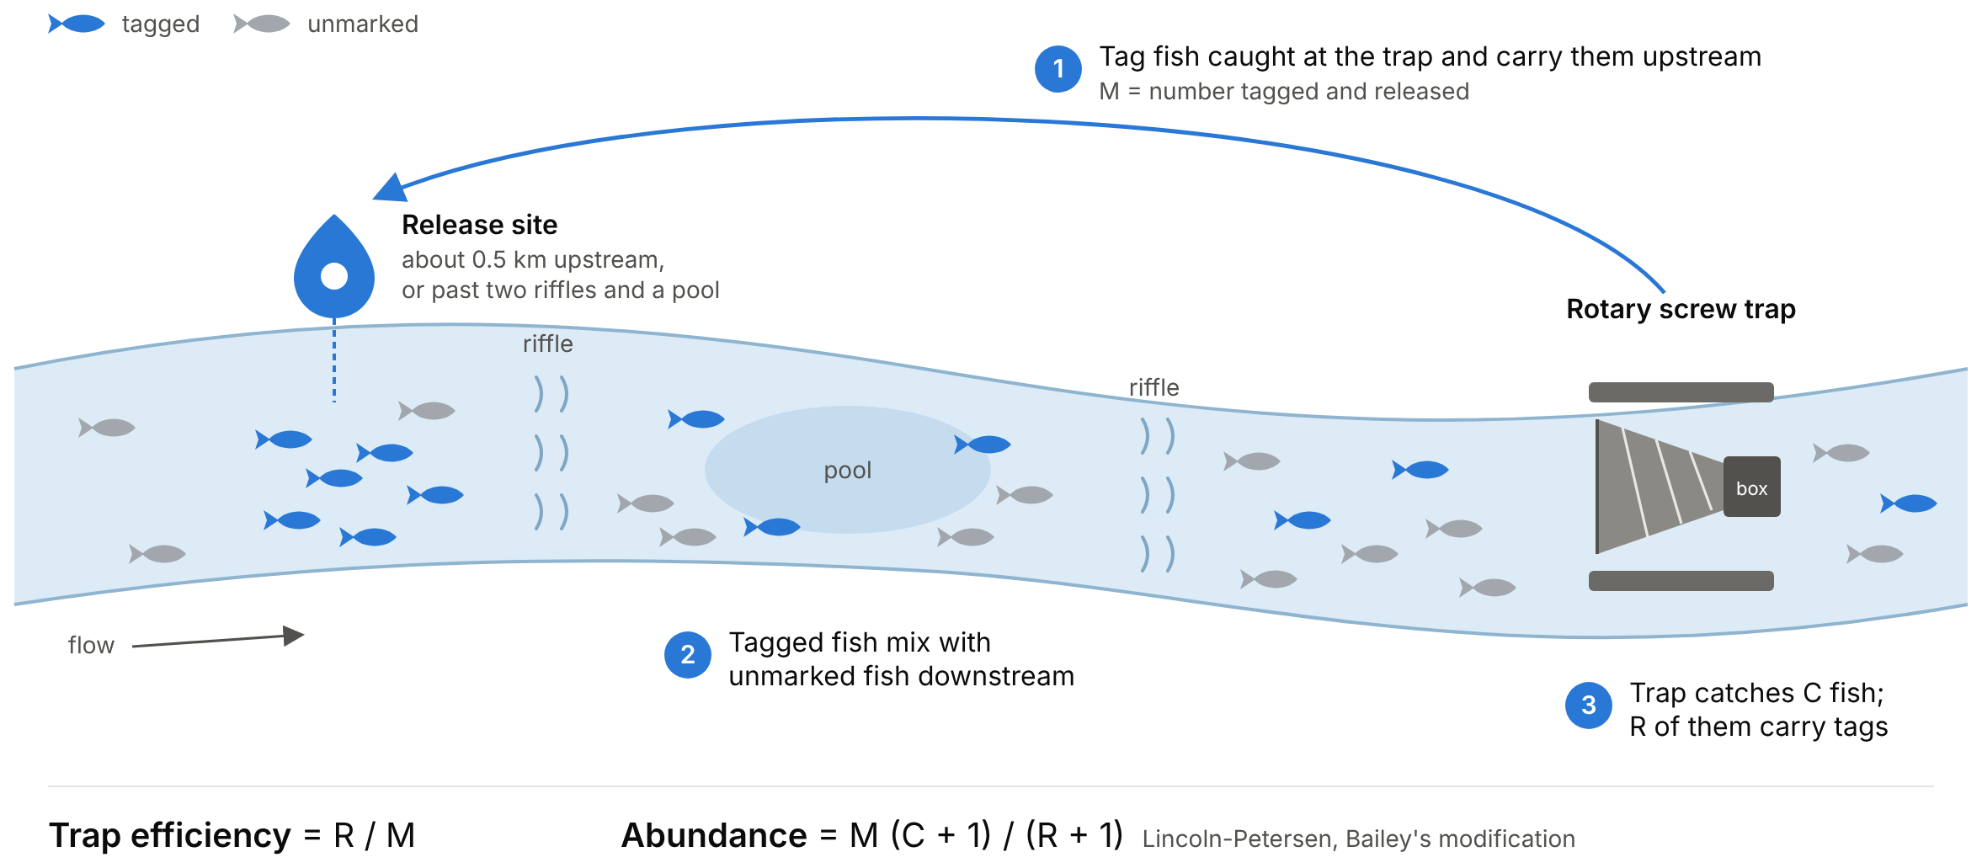
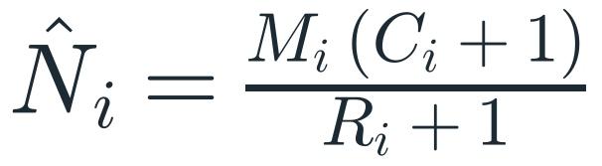
We Control the Marks
PART 1 · STARTING WITH SCREW TRAPS
Stratified Lincoln-Petersen, Bailey's modification
TOY NUMBERS
M = 200 marked, C = 1,000 caught, R = 20 recaptured
Estimate 9,533 (plain Petersen: 10,000)
Two problems
Days with zero recaptures force pooling into multi-day or multi-week strata
Trap outages give no estimate at all
Fish caught at the trap are tagged, carried upstream, and released to mix with unmarked fish.
IDFG now fits a daily state-space version of this. It needs no hand-picked strata, still estimates through trap outages, and works where declining runs leave too few recaptures for the stratified estimator.
Code: github.com/dsmi313/BSUecostats · 01_first_bayesian_model.R, 02_lincoln_petersen.R, 04_state_space_screwtrap.R
Notes:
Fish caught in the rotary screw trap are PIT tagged (or stained or fin clipped) and released about 0.5 km upstream, or at least two riffles and a pool above the trap, so they mix with unmarked fish (Smith et al. 2025).
Trap efficiency is just recaptures over marks.
Stratified Lincoln-Petersen with Bailey's modification: N-hat_i = M_i (C_i + 1) / (R_i + 1).
Toy numbers, labeled as such: M = 200, C = 1,000, R = 20 gives 9,533; plain Petersen gives 10,000.
Two problems: days with zero recaptures force pooling into multi-day or multi-week strata, and trap outages produce no estimate at all (Young et al. 2025).
What IDFG does now: a daily state-space version of this, because it needs no hand-picked strata, still estimates through trap outages, and works at traps where declining runs leave too few recaptures for the stratified estimator (Smith et al. 2025; Young et al. 2025).

Slide 5
The Bridge: What Changes at LGR
PART 1 · STARTING WITH SCREW TRAPS
 | Screw trap | Lower Granite
Who marks fish | We do, at the trap | Others, upstream (traps, hatcheries)
Marks released | Known, by us | Not under our control
Capture probability | Recaptures / marks | Sample rate (known) × GE (unknown)
What we never see | Unmarked fish we miss | Every fish that skips the bypass
At LGR we set the sample rate. GE has to be inferred from tags nobody placed for this purpose.
Notes:
Takeaway: at LGR we set the sample rate. GE has to be inferred from tags nobody placed for this purpose.

Slide 6
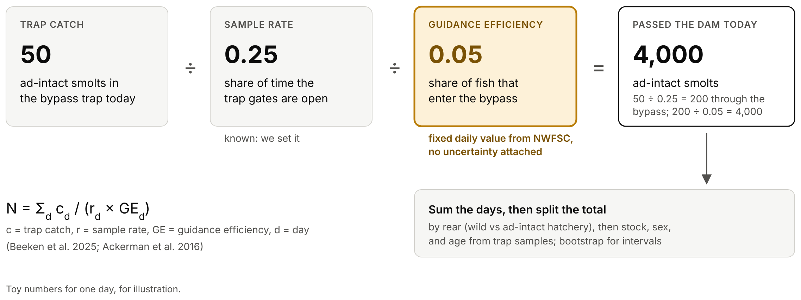
How SCRAPI Works Now
PART 2 · LOWER GRANITE, ONE PIECE AT A TIME
Two divisions. We set the first. The second arrives as a fixed number, with no uncertainty attached.
Notes:
Expand each day's wild (ad-intact) trap catch by sample rate and GE, decompose to wild vs ad-intact hatchery by stratum, then to stock, sex, and age; bootstrap for intervals (Beeken et al. 2025; Ackerman et al. 2016).
GE arrives as a fixed daily value from NWFSC. No uncertainty attached.
The figure uses toy numbers for one day, for illustration.

Slide 7
Where SCRAPI's Interval Comes From
PART 2 · LOWER GRANITE, ONE PIECE AT A TIME
1
Redraw the catch
Same toy day: 4,000 fish pass, and each has a 0.25 × 0.05 = 0.0125 chance of being caught. New catches: 53, 51, 51, 56, 50, ...
2
Expand it
Each catch ÷ 0.0125: 4,240, 4,080, 4,080, ...
3
Repeat 2,000 times
The middle 90% of the totals is the interval: 3,120 to 4,960. The measured fish are resampled too, so the wild, stock, sex, and age splits get intervals as well.
Toy numbers, simulated from the slide 6 example.
GE is the same 0.05 in every round, so the interval knows nothing about GE uncertainty. SCRAPI2 gives each round its own GE draw.
Code: github.com/dsmi313/BSUecostats · 08_bootstrap.R
Notes:
SCRAPI's bootstrap, per round (smoltEASE SCRAPI code): redraw each day's trap catch from a binomial with p = sample rate x GE, treating the estimated passage as fixed (rbinom(1, dailypass, Ptrue)); expand it back up; and resample the measured fish within each stratum, with replacement, for the wild/hatchery, stock, sex, and age splits. Repeat B times; the middle 90% of the totals is the interval.
Toy day from the previous slide: 4,000 fish pass, catch probability 0.25 x 0.05 = 0.0125, so about 50 fish. First five simulated catches: 53, 51, 51, 56, 50, which expand to 4,240, 4,080, 4,080, 4,480, 4,000. Over 2,000 rounds, the middle 90% is 3,120 to 4,960. These are simulated toy numbers, not a real day.
Say: GE is the same 0.05 in every round, so the interval carries trap-sampling noise but nothing about GE uncertainty, even though GE is the shakiest input. SCRAPI2 gives every round its own GE draw from the posterior. That comes back on the Jensen slide.

Slide 8
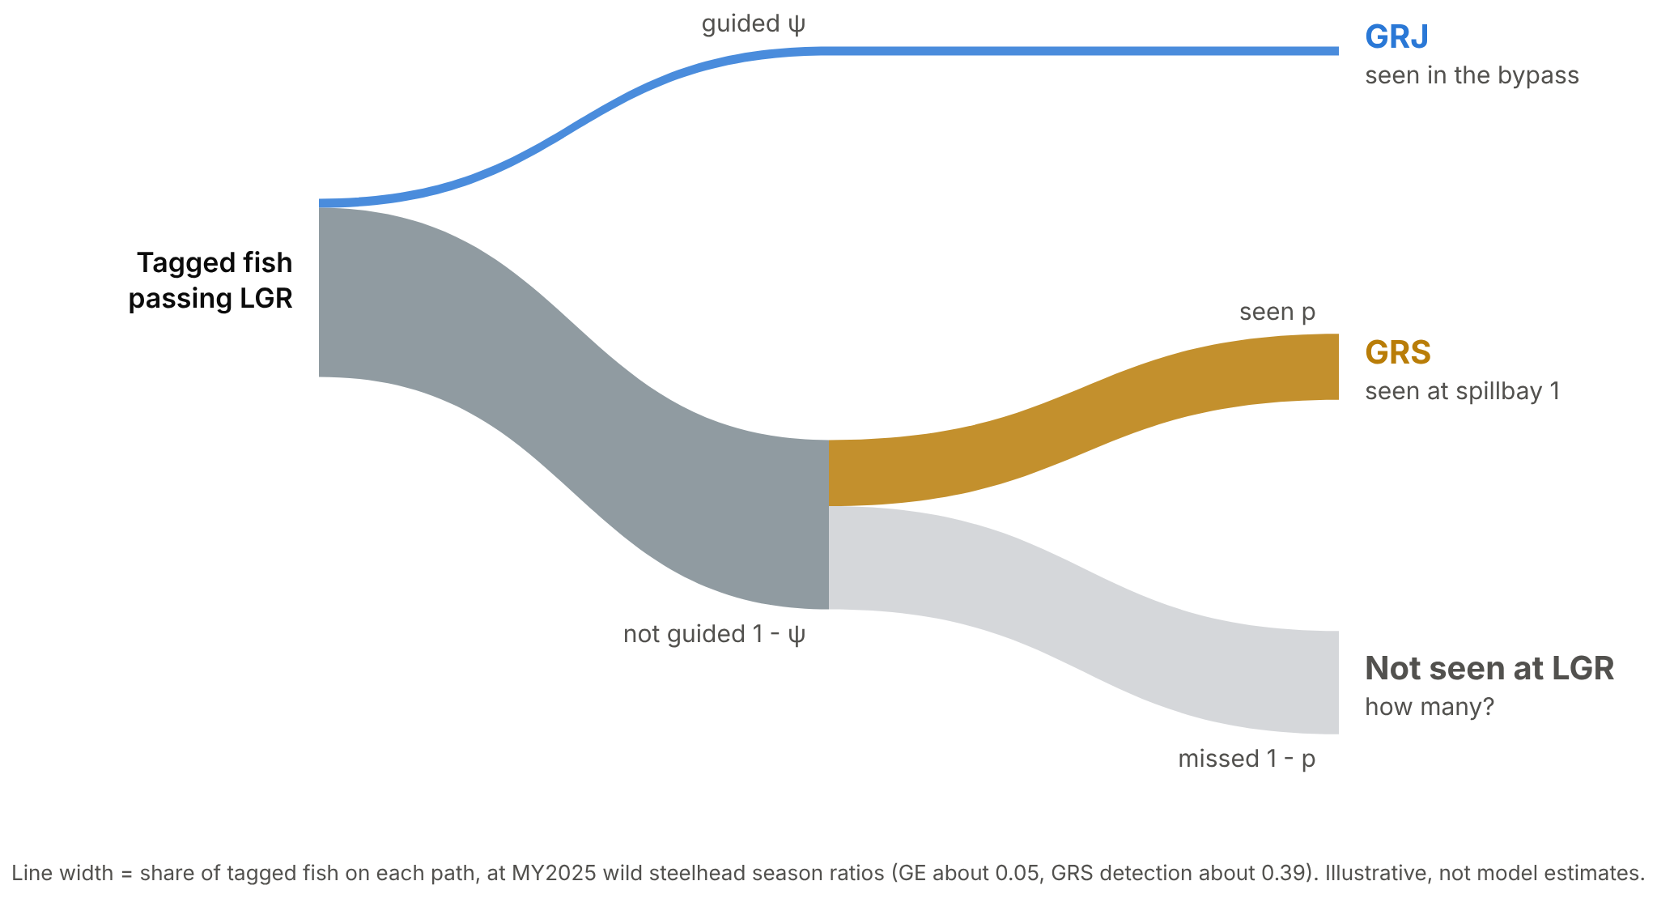
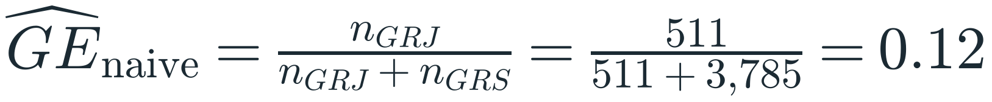
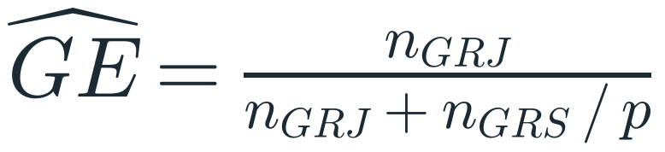
Step 1: Here Are Our PIT Counts
PART 2 · LOWER GRANITE, ONE PIECE AT A TIME
RUNNING GE 0.12
511
3,785
GRJ, the bypass
GRS, spillbay 1
MY2025 wild steelhead, first detections at LGR
What's missing? Detection probability for spilled fish.
Season totals. Every GE on slides 8 to 11 is closed form from these counts, not model output.
Notes:
MY2025 wild steelhead, first detections at LGR: GRJ 511 (bypass, 156 of them then transported), GRS 3,785.
Naive GE = 511 / (511 + 3,785) = 0.12.
Ask the room: what's missing? Detection probability for spilled fish.
Corrected: GE = n_GRJ / (n_GRJ + n_GRS / p).
Counts are season totals from six_cell_counts.csv (detection.zip). Every GE on slides 8 to 11 is closed form, not model output.
Tree: guided vs not guided; GRS seen vs missed. Line width = share of tagged fish at MY2025 wild season ratios, so the big grey "how many?" branch makes the point.

Slide 9
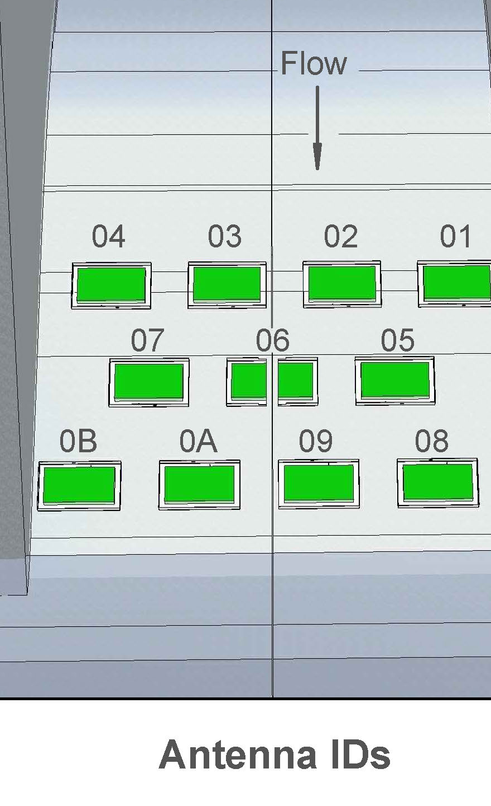
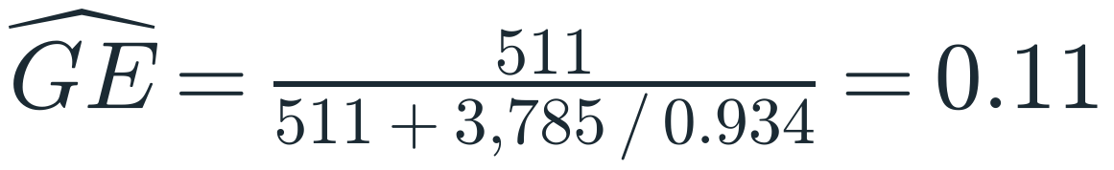
Step 2: The Row Method
PART 2 · LOWER GRANITE, ONE PIECE AT A TIME
RUNNING GE 0.12 → 0.11
11 flatplate antennas sit in three rows across spillway 1: 01 to 04, then 05 to 07, then 08 to 0B. A spilled fish crosses all three rows.
111
110
101
011
100
010
001
Every fish GRS reads carries one of these row histories. MY2025: 72,791 histories, 3,785 of them wild.
Same logic as Lincoln-Petersen: of the fish row 2 read, the share row 1 also read estimates row 1's detection (BPA Ch. 6, Model Mt). It assumes every fish is equally readable. Fish one row struggles with are probably hard for all three, which would make the array look better than it is.
SHARE OF WILD FISH READ
MISSED BY EVERY ROW SO FAR
Row 1
64%
36%
Rows 1 and 2
86%
36% × 39% = 14%
All three rows
93%
14% × 47% = 6.6%
d = 1 - (1 - 0.64)(1 - 0.61)(1 - 0.53) = 0.93. The array misses a fish only if every row misses it.
Barely moved.
PTAGIS: Lower Granite Dam Spillway (GRS), Interrogation Site Configuration 100, Drawing Rev 0
Notes:
GRS's 11 flatplate antennas sit in three rows across spillway 1, one after another down the flow path (PTAGIS GRS configuration drawing): 01 to 04, then 05 to 07 (06 is split in two to straddle the center expansion joint), then 08, 09, 0A, and 0B. Each antenna is 44.5 by 86.5 inches.
A spilled fish crosses all three rows, so every fish GRS detects carries a three-digit row history: 111, 110, 101, 011, 100, 010, or 001. MY2025: 72,791 histories, 3,785 of them wild.
Same logic as Lincoln-Petersen: of the fish row 2 read, the share row 1 also read estimates row 1's detection. With three rows it's a closed-population model with row-specific detection (BPA Ch. 6, Model Mt, with rows in place of occasions). Weak spot: it assumes every fish is equally readable. If fish passing deep or between antennas are hard for all three rows (heterogeneity, BPA's Model Mh), the 6.6% missed by every row is an underestimate.
MY2025 wild row detection (posterior means): row 1 0.642, row 2 0.610, row 3 0.527. Missed by row 1: 36%. Missed by rows 1 and 2: 0.358 x 0.390 = 14%. Missed by all three: 0.14 x 0.473 = 6.6%, so the array reads d = 1 - 0.066 = 0.934 for wild (0.936 hatchery). Say: three mediocre rows make a very good array, because a fish only slips through if every row misses it.
Plug it in: GE = 511 / (511 + 3,785 / 0.934) = 0.11. Barely moved.
Say: a fish that crosses bay 1 almost never slips past the antennas. So is that the whole story? What if I told you there were more paths?
Check before presenting: row and array estimates are from joint_posterior_summary.csv in detection.zip (MY2025, smoltEASE 0.1.9 in sessionInfo). Confirm it's the run to show, and which physical row is row 1, 2, and 3 in the model.

Slide 10
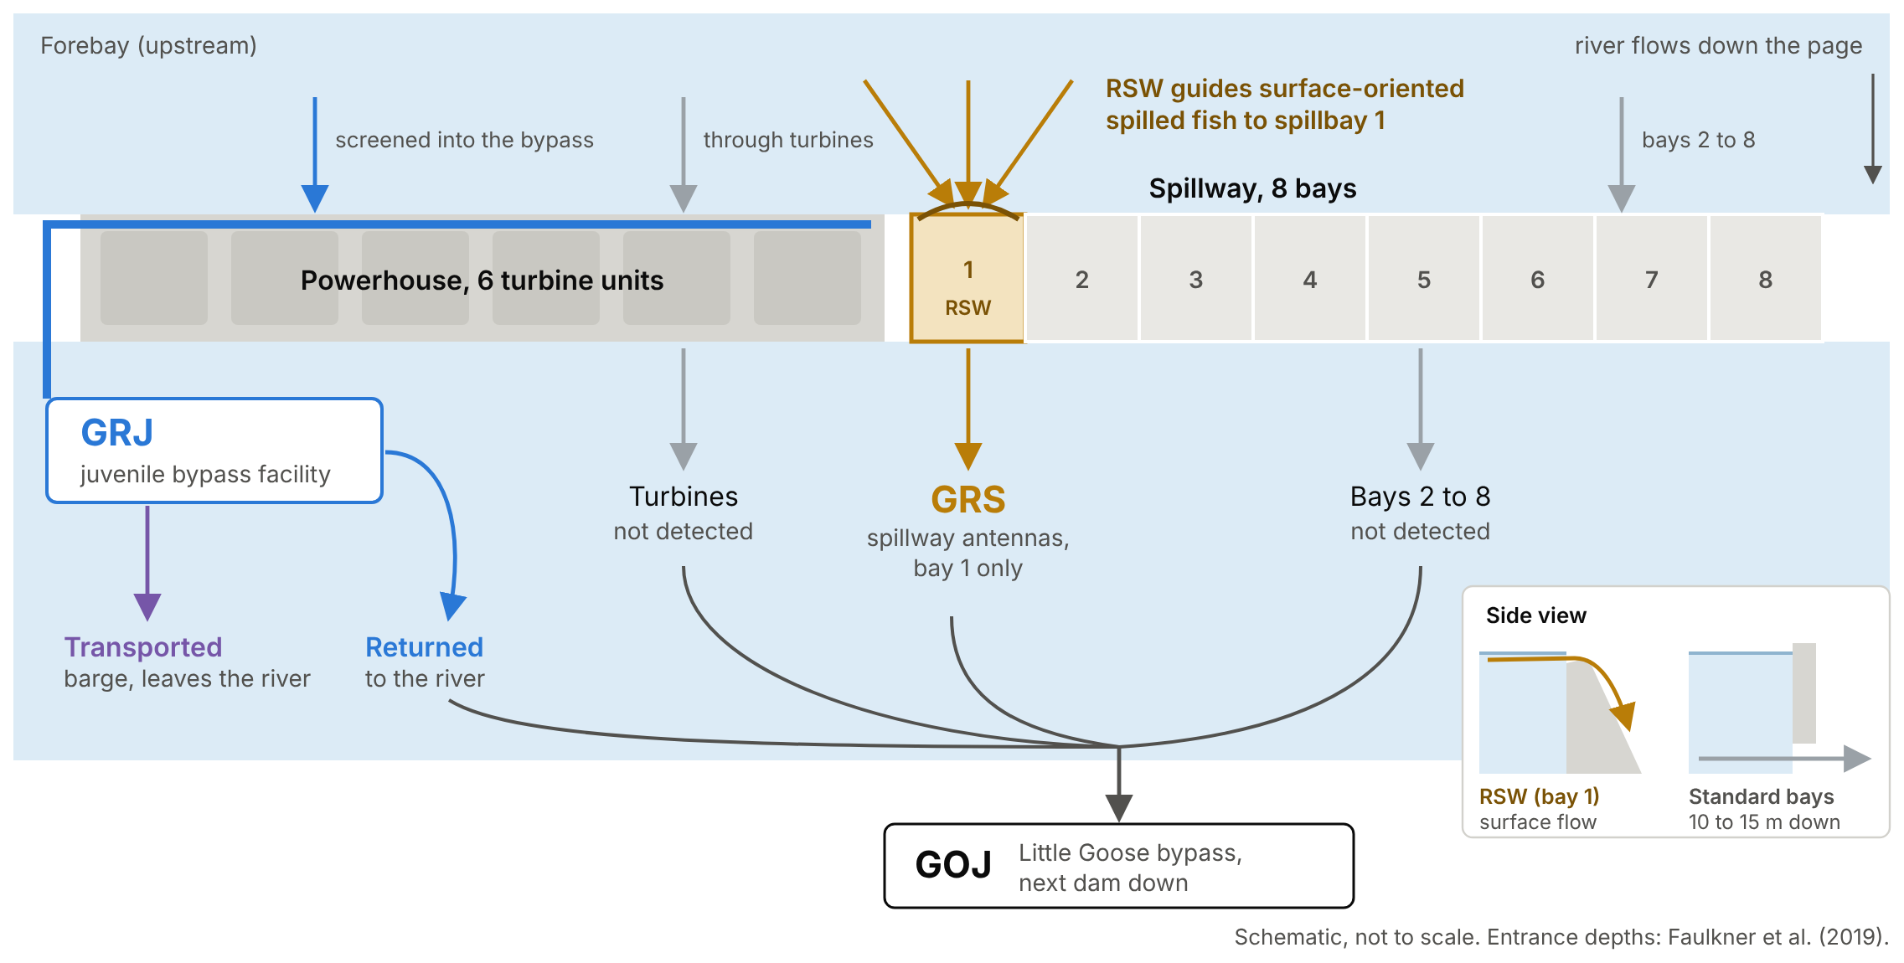
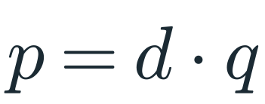
More Paths: Three Places a Fish Can Be Detected
PART 2 · LOWER GRANITE, ONE PIECE AT A TIME
GRJ
Juvenile bypass, running since 1988. The model assumes every guided fish is seen here.
GRS
Spillbay 1 only, since April 2020. The RSW guides surface-oriented spilled fish to bay 1.
GOJ
Little Goose bypass, the next dam down. A second look at every route.
GRS detection is two things: d, how well the array reads a fish in bay 1 (0.93, from the rows), and q, the share of nonguided fish that pass through bay 1, turbines included. The rows can't tell us q. A second look downstream can.
Notes:
What if I told you there are more paths? Eight spill bays plus turbines, and GRS sits in bay 1 only.
GRJ: LGR juvenile bypass and transportation facility, running since 1988 (PTAGIS). The model assumes every guided fish is detected here.
GRS: spillbay 1 only, 11 flatplate antennas in the spillway concrete, data from April 2020 (PTAGIS). The only spillway array among the eight dams Idaho's emigrants pass (Smith et al. 2025).
GOJ: Little Goose bypass, the next dam down.
The removable spillway weir (RSW) in bay 1 guides surface-oriented spilled fish to spillbay 1. Spillway weirs take fish from the first few meters of the surface; standard spillbay entrances are 10 to 15 m down (Faulkner et al. 2019). Installed permanently in 2001 (Hance et al. 2024).
GRS detection is really two things: p = d x q. Array detection d comes from the rows (0.93). q is the share of nonguided fish that go through bay 1, and "not guided" includes the turbines, so q covers every non-bypass route.
Say: how many spilled fish the weir pulls into bay 1 isn't fixed. At low flow, high spill pushes passage toward the deep bays and away from the weir (Harnish et al. 2023). That's why q has to be estimated, not assumed.
Check before presenting: six vs eight spill bays. Hance et al. 2024 say "one of the six spillbays"; other sources list eight spillway gates. The PTAGIS GRS drawing shows spillway 1 next to the powerhouse, matching the schematic.

Slide 11
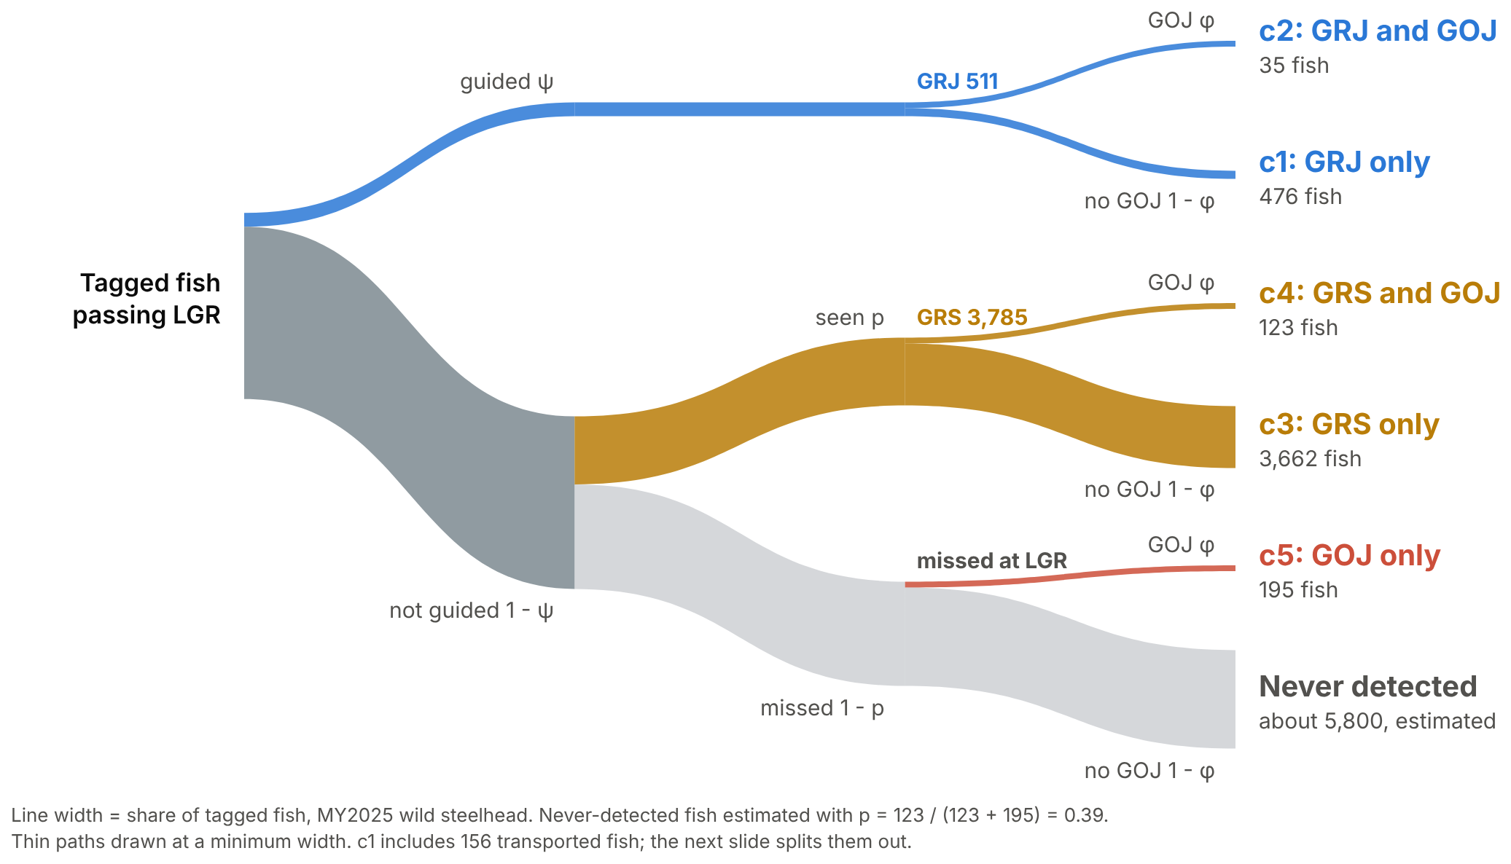
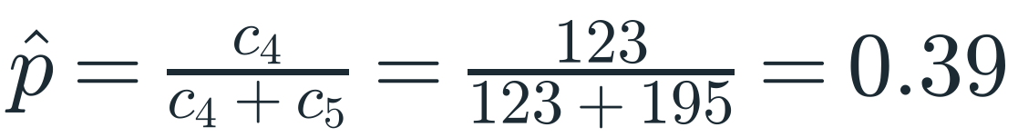
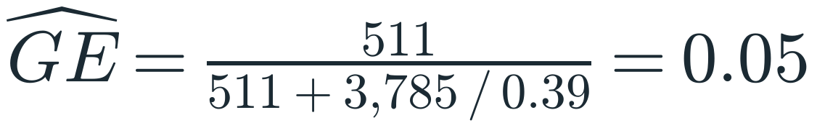
Step 3: Add a Downstream Site
PART 2 · LOWER GRANITE, ONE PIECE AT A TIME
RUNNING GE 0.12 → 0.11 → 0.05
Cell | Detected at | Probability
c1 | GRJ only | ψ(1 - φ)
c2 | GRJ and GOJ | ψφ
c3 | GRS only | (1 - ψ) p (1 - φ)
c4 | GRS and GOJ | (1 - ψ) p φ
c5 | GOJ only | (1 - ψ)(1 - p) φ
none | Nowhere | (1 - ψ)(1 - p)(1 - φ)
# condition on being detected: only fish we can see
p_seen[r,s] <- sum(pi_raw[r,s,1:5])
for (cc in 1:5) { pi_obs[r,s,cc] <- pi_raw[r,s,cc] / p_seen[r,s] }
c4 and c5 skipped the bypass and were both detected at GOJ. They differ only in whether GRS read them, so GOJ recovery cancels:
The likelihood only deals with fish we can detect; never-detected fish drop out.
Lincoln-Petersen logic: GOJ is a second sample.
It assumes GRS-read and GRS-missed fish survive to and are detected at GOJ at the same rate.
MY2025 wild. With d = 0.93 from the rows, q = p / d ≈ 0.41. Route at LGR is the hidden state: a multistate model (BPA Ch. 9).
Code: github.com/dsmi313/BSUecostats · 05_six_cell.R (section 8: what happens without GOJ)
Notes:
The key move: c4 and c5 both skipped the bypass and were both detected at GOJ. They differ only in whether GRS read them, so p-hat = c4 / (c4 + c5). Recovery at Little Goose (surviving to GOJ and being detected there) cancels.
That is Lincoln-Petersen logic, not the LP estimator: GOJ acts as a second sample, and the share of it GRS already read estimates p. No N is estimated here, and the model estimates p jointly in the multistate likelihood; the ratio is the back-of-envelope version. The equal-catchability assumption is the weak spot: GRS-read fish all used bay 1 and the weir, while GRS-missed fish include other bays and the turbines, so different survival to Little Goose would bias p.
MY2025 wild: c4 = 123 and c5 = 195, so p-hat = 0.39 and GE = 511 / (511 + 3,785 / 0.39) = 0.05. With d = 0.93 from the rows, q = p / d, about 0.41.
The running total for the room: GE 0.12 naive, 0.11 with the rows, 0.05 with GOJ.
The model's weekly wild q runs 0.29 to 0.54 (detection.zip).
Likelihood: the code box shows the conditioning step, written with 1:5 to match this slide's five detectable cells. In fit_ge_rear_daynight.R the same lines run over 1:11 (the day/night cells, slide 22), followed by n[...,1:11] ~ dmulti(pi_obs[...,1:11], N_seen[...]): the detected fish, N_seen, are a multinomial over the detectable cells. p_seen is the probability of being detected anywhere; dividing by it makes the detectable cells sum to 1, so never-detected fish never enter the likelihood.
It needs GRS-read and GRS-missed nonguided fish to be recovered at GOJ (survive and be detected) at the same rate.
This is a multistate model (BPA Ch. 9): the route at LGR is the hidden state, and the detections are what we observe.
Tree: five cells plus the never-detected leaf, MY2025 wild counts. The thin c4 and c5 paths are the fish that identify p.

Slide 12
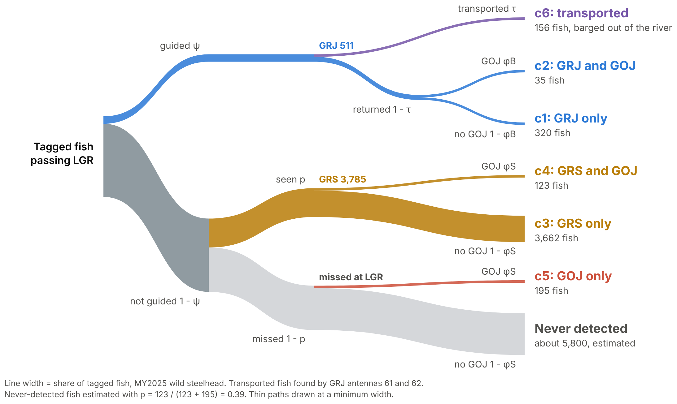
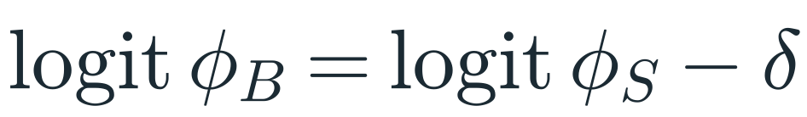
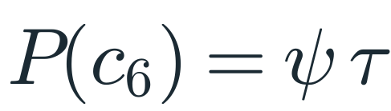
Step 4: Two Complications
PART 2 · LOWER GRANITE, ONE PIECE AT A TIME
1
Recovery differs by route
Recovery = survive to GOJ and be detected there. It differs for bypassed and spilled fish.
2
Transport: barged fish never reach GOJ
A sixth cell, c6.
# recovery: spilled fish on the logit scale; bypassed fish shifted by delta
phi_S[r,s] <- ilogit(logit_phi_S[r,s])
phi_B[r,s] <- ilogit(logit_phi_S[r,s] - delta[r,s])
# transport: flat prior on the probability scale
trans[r,s] ~ dbeta(1, 1)
# guided fish now split three ways
pi_raw[r,s,1] <- psi[r,s] * (1-trans[r,s]) * (1-phi_B[r,s]) # c1: GRJ only
pi_raw[r,s,2] <- psi[r,s] * (1-trans[r,s]) * phi_B[r,s] # c2: GRJ and GOJ
pi_raw[r,s,6] <- psi[r,s] * trans[r,s] # c6: transported
Find barged fish by the GRJ barge-load antennas (61 and 62), not the LGRRBR release flag. The flag missed 1,738 barged fish, 156 of them wild, and pulled φB down by about a third.
JAGS from smoltEASE, simplified to this slide's six cells; comments added.
Code: github.com/dsmi313/BSUecostats · 05_six_cell.R
Notes:
Recovery means surviving to GOJ and being detected there; the data can't separate the two. Recovery differs by route: logit φB = logit φS - δ.
Transport: guided fish loaded on barges never reach GOJ. Sixth cell, c6, probability ψ x τ.
Find transported fish by the GRJ raceway barge-load antennas (61/62), not the LGRRBR release flag. The flag missed 1,738 barged fish, 156 of them wild, and that suppressed φB by about a third.
If anyone asks what logit means here: slide 16 explains it. δ is the route gap on the logit scale.
Tree: purple transport branch off GRJ, c1 now 320 without the 156 barged fish, and GOJ recovery labeled φB for bypassed fish and φS for spilled fish.
Code panel: the phi_S, phi_B, and trans ~ dbeta(1, 1) lines are exact from fit_ge_rear_daynight.R (consistent structure). phi_S has its own logit regression on Little Goose spill in the file, left out here. The three cell lines are simplified to this slide's six cells: in the file they use psi_day times (1 - a) for day fish, transport is cell 5 (10 at night), and the night versions use psi_night and a.

Slide 13
Gotcha: Fish Tagged After the Decision
PART 2 · LOWER GRANITE, ONE PIECE AT A TIME
Fish tagged and released inside the LGR facility (LGRRBR, LGRRRR, LGRTAL) are in the data only because they were already guided. Most land in c6.
45%
of MY2025 wild histories (3,689 of 8,219). Dropping them moved season wild GE from 0.186 to 0.048.
Same lesson as the screw trap: marks have to go on before the process you're estimating, or they aren't a sample of it.
Closed-form season GE from PIT counts, not model output.
Code: github.com/dsmi313/BSUecostats · 05_six_cell.R, section 7
Notes:
Fish tagged and released inside the LGR facility (LGRRBR, LGRRRR, LGRTAL) are in the data only because they were already guided. Most land in c6.
MY2025: 3,689 of 8,219 wild histories (45%). Dropping them moved season wild GE from 0.186 to 0.048.
By year (share dropped; wild GE before, after): 2021 24%, 0.128, 0.037; 2022 50%, 0.256, 0.151; 2023 59%, 0.272, 0.224; 2024 46%, 0.230, 0.044; 2025 45%, 0.186, 0.048.
Closed-form season GE, not model output.
Same lesson as the screw trap: marks have to go on before the process you're estimating, or they aren't a sample of it.

Slide 14
Most of the PIT Fish Are Hatchery
PART 3 · WILD FISH IN A HATCHERY RIVER
77,581
4,491
17 to 1
hatchery detection histories, MY2025
wild detection histories, MY2025
hatchery tags for every wild tag
hatchery 94.5%
wild 5.5%
Wild weeks are thin. Weeks are grouped into strata until each holds more than 10 fish informing detection (c4 + c5) and more than 10 informing recovery (c3 + c4). MY2025 wild: 9 strata, with weeks 22 to 26 pooled.
Hatchery fish pass the same dam, under the same spill, in the same weeks.
Can wild borrow from them?
Notes:
MY2025: 77,581 hatchery histories vs 4,491 wild, about 17 to 1 (six_cell_counts.csv).
Wild weeks are thin. Weeks are grouped into strata until each holds more than 10 fish informing detection (c4 + c5) and more than 10 informing recovery (c3 + c4). MY2025 wild: 9 strata, with weeks 22 to 26 pooled.
Hatchery fish pass the same dam, under the same spill, in the same weeks. Can wild borrow from them?

Slide 15
Borrow Strength, Keep Wild GE Wild
PART 3 · WILD FISH IN A HATCHERY RIVER
Shared by wild and hatchery
Kept separate for each rear type
Stratum averages
Spill and outflow slopes
How much weeks wiggle
A wild or hatchery offset: fixed effects, centered to sum to zero
Each rear-week's own value
Two rear types are too few to estimate an among-rear variance (BPA 4.1.4).
r = 0.81 to 0.96
weekly wild vs hatchery GE correlation, MY2021 to 2025, once the LGR-tagged fish are dropped (0.40 to 0.71 with them)
Rule we hold to: wild is the target, so no setting gets tuned to fit hatchery fish better at wild's expense.
Code: github.com/dsmi313/BSUecostats · 06_hierarchical.R
Notes:
Shared by rear types: stratum averages, spill and outflow slopes, how much weeks wiggle.
Separate: a wild or hatchery offset, plus each rear-week's own value.
Offsets are fixed effects, centered to sum to zero. With only two rear types there's too little to estimate among-rear variance (BPA section 4.1.4: factors with fewer than about 5 to 10 levels are rarely treated as random).
Check that sharing is reasonable: weekly wild vs hatchery GE correlation is r = 0.81 to 0.96 across MY2021 to 2025 once the LGR-tagged fish are dropped (0.40 to 0.71 with them).
Rule we hold to: wild is the target, so no setting gets tuned to fit hatchery fish better at wild's expense.
Related approach for mixed-origin fish at LGR: Hance et al. (2024), fall Chinook.

Slide 16
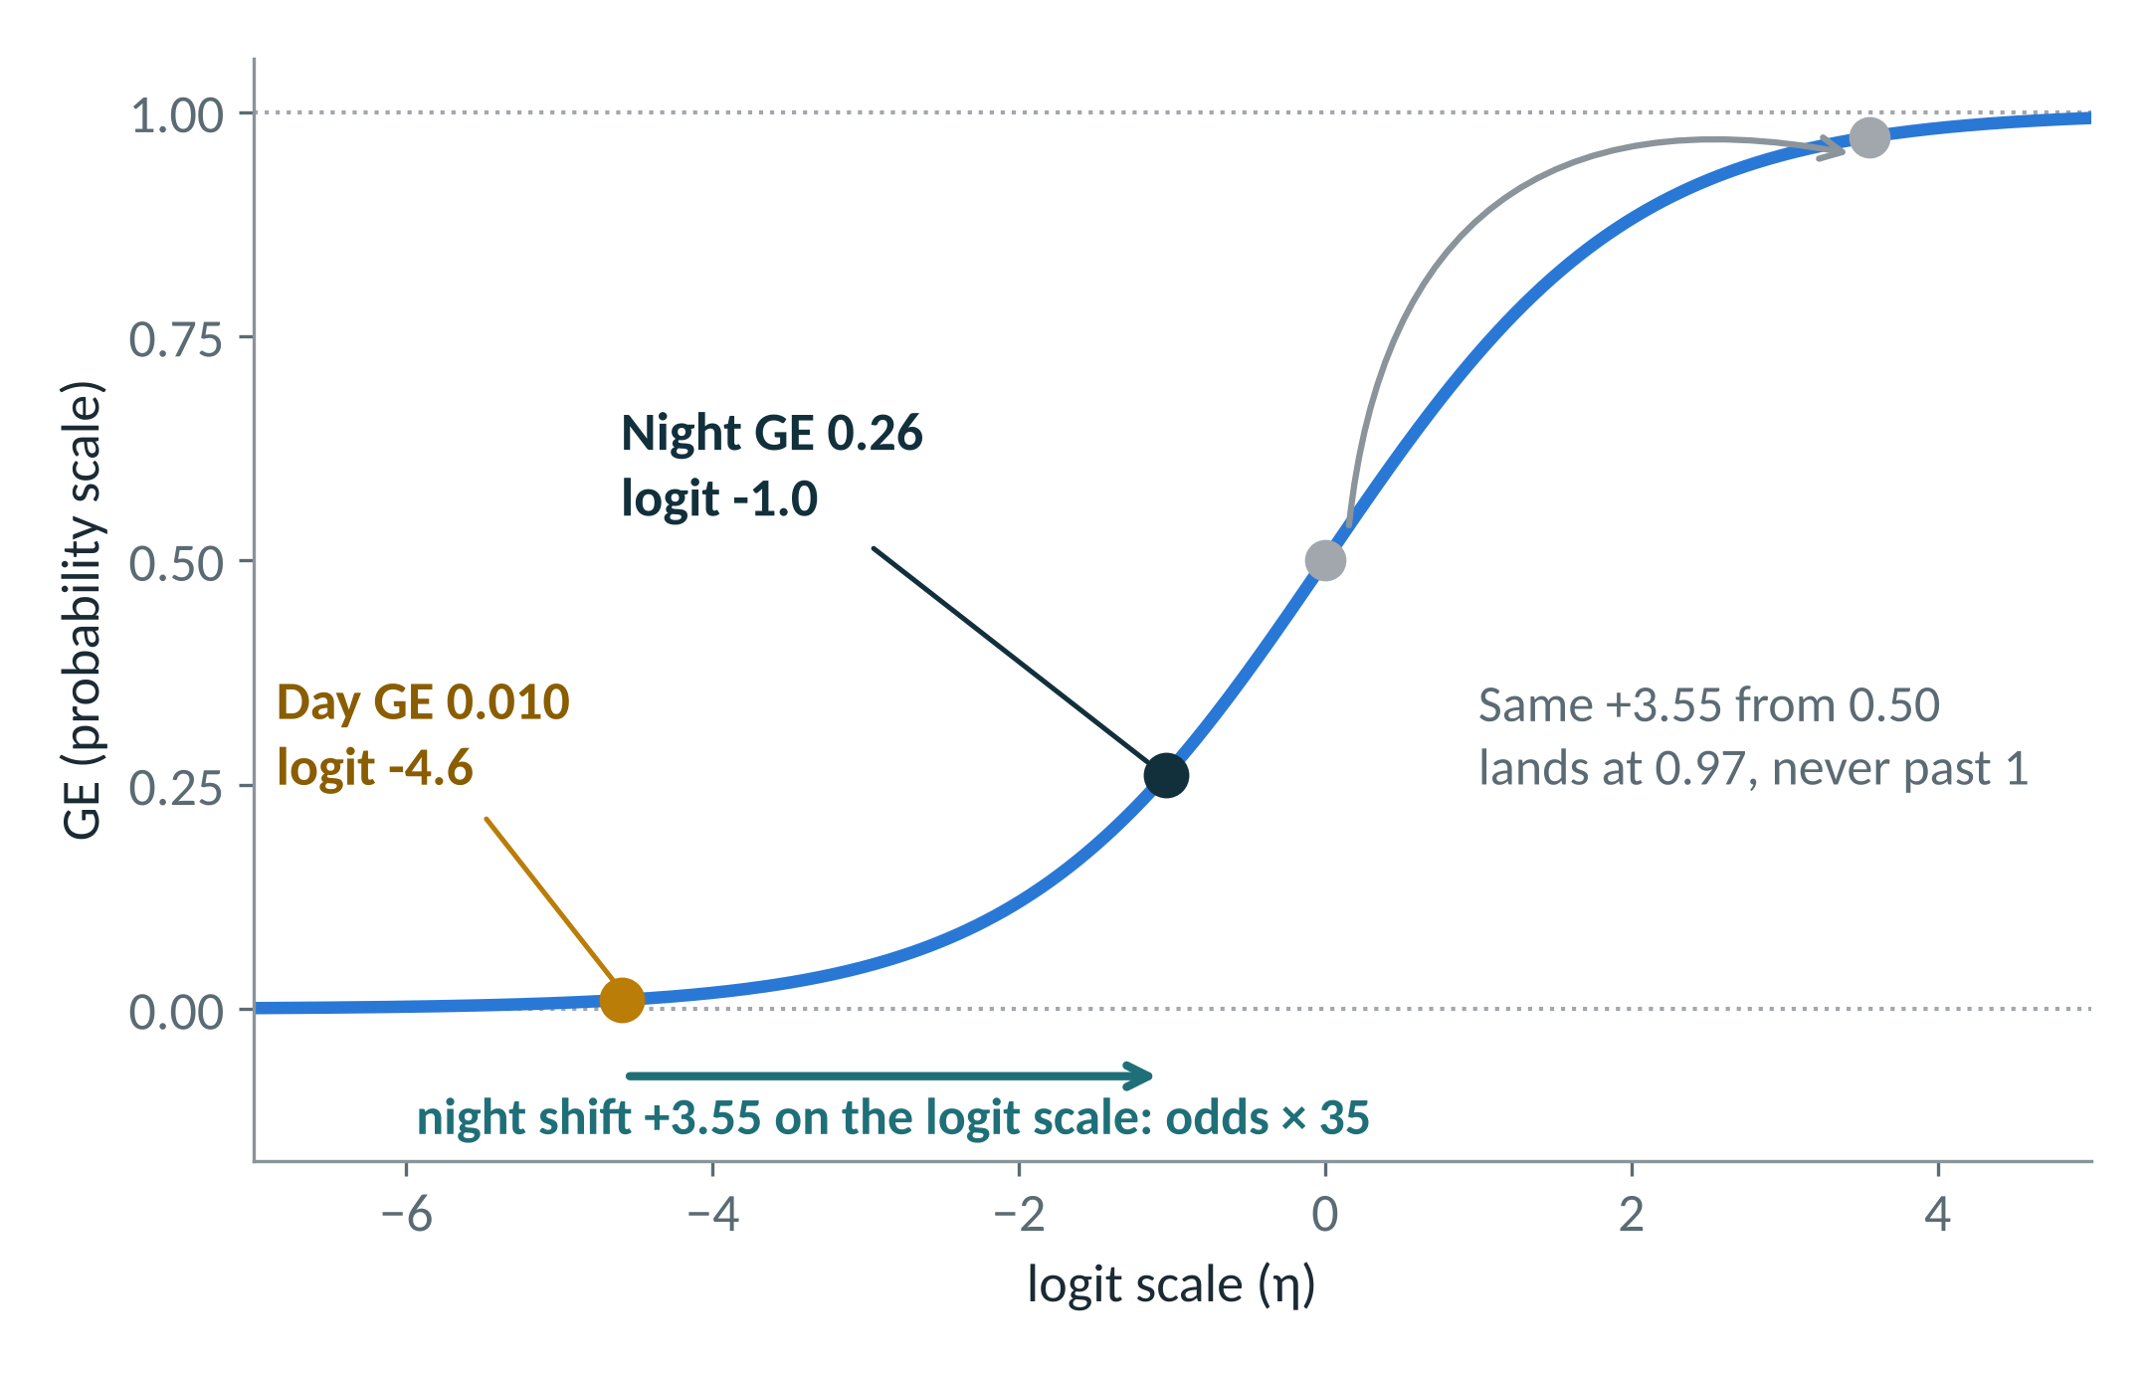
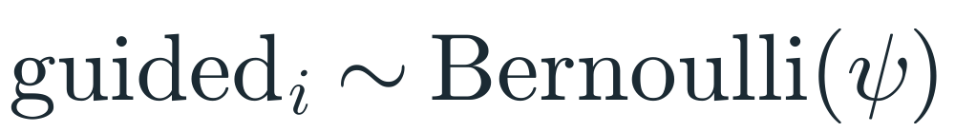
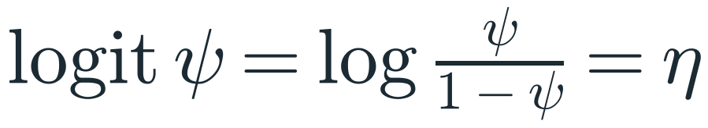
Why Model GE on the Logit Scale
PART 3 · WILD FISH IN A HATCHERY RIVER
A GLM in three lines (BPA 3.2.3)
1
Noise: each tagged fish is a Bernoulli trial, guided or not.
2
Link: the logit maps 0 to 1 onto the whole real line. Effects add here, so they multiply the odds.
3
Signal: a linear predictor, “up to your data, your questions, and your imagination” (BPA 3.5).
Back-transform: ψ = 1 / (1 + e^(-η)). Linear in the parameters, but an S-curve on the probability scale (BPA 3.2.2). Points: MY2025 wild steelhead, closed-form season ratios.
“Many of the most exciting ecological models for inference about populations can be viewed simply as a sequence of coupled GLMs” (BPA 3.2.3).
Ours couples logit GLMs for guidance ψ, GRS detection p, and Little Goose recovery φ.
Code: github.com/dsmi313/BSUecostats · 03_bernoulli_logit.R
Notes:
BPA Chapter 3 frames every GLM in three parts (3.2.3): a random part (the noise, a statistical distribution), a link function, and a systematic part (the signal, a linear predictor). For GE: each tagged fish is a Bernoulli trial, guided or not with probability ψ (BPA 3.5: a binomial with N = 1 is a Bernoulli); the link is the logit; the linear predictor is the next slide's regression.
Why a link at all: adding binomial noise straight onto a linear predictor gives inadmissible values (BPA 3.2.3). The logit "maps the probability scale (i.e., the range from 0 to 1) onto the entire real line ... and ensures that a linear model does not result in probabilities outside of that admissible range, that is, below 0 or above 1" (BPA 3.5).
"The rest of the model (the linear predictor ηi) is up to your data, your questions, and your imagination" (BPA 3.5).
A linear model "is linear in the parameters and does not need to represent a straight line when plotted; most often it does not" (BPA 3.2.2). The S-curve is our linear model seen on the probability scale. Back-transform: ψ = 1 / (1 + e^(-η)).
Adding on the logit scale multiplies the odds: +1 multiplies the odds by e, about 2.7. MY2025 wild, closed-form season ratios: day GE 0.010 is logit -4.6; night GE 0.261 is logit -1.04. The night shift of about +3.55 multiplies the odds of being guided about 35 times. The same +3.55 from GE 0.50 lands at 0.97, never past 1.
Coupled GLMs: "Many of the most exciting ecological models for inference about populations can be viewed simply as a sequence of coupled GLMs (Royle and Dorazio, 2008)" (BPA 3.2.3). In smoltEASE's day/night model, guidance ψ, GRS detection p, and Little Goose recovery φS are each logit-linear with their own spill covariate, and φB is φS shifted by δ on the logit scale. Transport τ is the exception: a flat Beta(1, 1) prior on the probability scale.
Practical: in R, qlogis() is the logit and plogis() maps back (BPA 3.5 simulates with plogis); in JAGS, logit() and ilogit().
Say: the next slide's regression is written on this scale. Every effect in it, rear offsets, spill, flow, and later the night shift, is a shift on the logit scale.

Slide 17
The Hierarchical GE Regression
PART 3 · WILD FISH IN A HATCHERY RIVER
r = rear type, s = week, g(s) = the week's stratum. The spill slope is constrained: β ≤ 0.
Season average
for (r in 1:R) {
for (s in 1:S) {
# each week's GE, on the logit scale
logit_psi[r,s] ~ dnorm(
mu_strat[parent[s]] + rear_psi[r] +
beta * psi_spill_std[r,s] +
beta_outflow * psi_outflow_std[r,s],
tau_psi)
# convert logit scale to probability scale
psi[r,s] <- ilogit(logit_psi[r,s])
}
}
# weeks shrink toward their stratum,
# strata shrink toward the season average
for (g in 1:n_strat) { mu_strat[g] ~ dnorm(alpha, tau_strat) }
# spill can only lower GE
beta ~ dnorm(0, pow(slope_sd, -2)) T(, 0)
# rear offsets: fixed, centered to sum to zero
rear_psi[r] <- rear_psi_raw[r] - rear_psi_mean
Stratum 1
Stratum 2
Stratum 3
JAGS from smoltEASE, trimmed; comments added. Day/night split: slide 21.
A week with many fish is set by its own fish; a thin week gets pulled toward its stratum.
Circle size = tagged fish that week (dashed: thin weeks). BPA tie-in: 7.4 (random time effects) and 7.6 (time and group effects).
Code: github.com/dsmi313/BSUecostats · 06_hierarchical.R
Notes:
logit ψ[r,s] = μ_strat[g(s)] + rear_r + β spill + β_flow outflow + ε, with β ≤ 0. Slide 21 shows that in the model this is day GE, with night as a shift on top.
Season average, then strata, then weeks. A week with many fish is set by its own fish; a thin week gets pulled toward its stratum. Circle sizes in the diagram are illustrative.
BPA tie-in: 7.4 (time variation, random time effects) and 7.6 (time and group effects).
Code panel: lines from smoltEASE fit_ge_rear_daynight.R, structure = "consistent", day_ge = "rear", trimmed to the psi regression. The # comments are added for teaching. The rear_psi line sits inside a loop over r in the file. The last loop line reads psi[r,s] <- ilogit(logit_psi[r,s]) as in fit_ge_rear_model2.R; in the day/night model the same line is psi_day[r,s], the week's daytime GE, and the week's overall GE is the blend psi[r,s] = (1 - a) psi_day + a psi_night (slide 21).

Slide 18
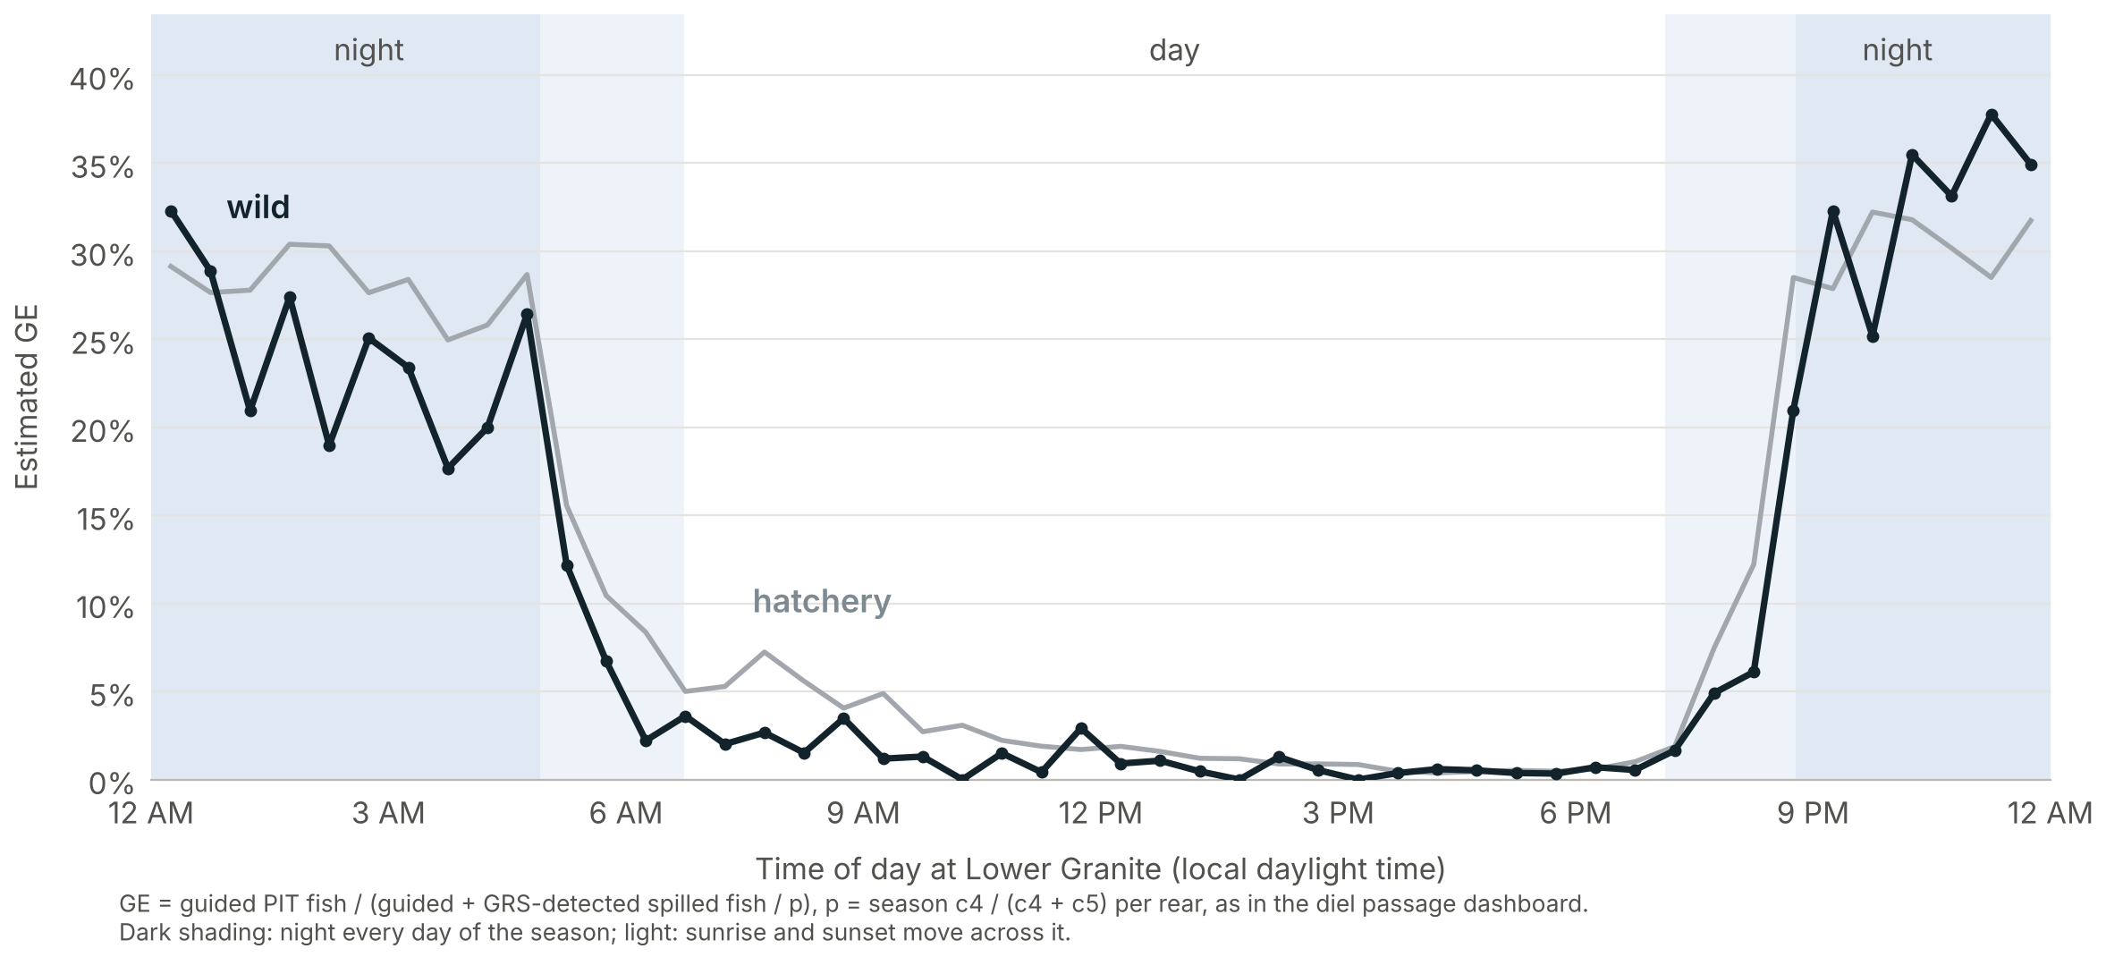
Day and Night GE Are Very Different
PART 4 · DAY AND NIGHT
1%
GE by day
26%
GE at night
16%
of wild fish arrive at night
MY2025 wild steelhead, closed-form season ratios
Independent support: acoustic telemetry 2008 to 2018 found steelhead powerhouse passage 1.6 to 2.0 times higher at night at Lower Granite, Little Goose, and Lower Monumental (Harnish et al. 2023). Powerhouse includes turbines, so it isn't GE, but it points the same way.
Code: github.com/dsmi313/BSUecostats · 07_day_night.R
Notes:
MY2025 wild steelhead, closed-form season ratios: day GE about 0.010, night GE about 0.261, night share of arrivals about 0.161. Not model estimates.
Figure: estimated GE by half hour, MY2025 steelhead, wild and hatchery, night shaded; same calculation as the diel passage dashboard.
Independent support: acoustic telemetry 2008 to 2018 found steelhead powerhouse passage 1.6 to 2.0 times higher at night at LGR, Little Goose, and Lower Monumental (Harnish et al. 2023). Powerhouse includes turbines, so it isn't GE, but it points the same way.

Slide 19
Simpson's Paradox
PART 4 · DAY AND NIGHT
TOY NUMBERS
Day GE falls. Night GE falls. Pooled GE rises, because more fish pass at night in week B.
 | Day GE | Night GE | Night share | Pooled GE
Week A, lower spill | 0.04 | 0.30 | 10% | 0.066
Week B, higher spill | 0.02 | 0.25 | 40% | 0.112
A to B | ▼ falls | ▼ falls | ▲ 4× | ▲ rises
Regress pooled GE on spill and it says more spill raised GE: the opposite of what happened by day and by night.
Even with no reversal, pooled GE moves whenever night share moves. So the expansion needs each day's own night share.
Pooled GE is guided fish over all fish. Week A: 3.6 guided by day plus 3.0 at night is 6.6 of every 100.
Notes:
Toy numbers, labeled as such.
Pooled GE = (1 - a) GE_day + a GE_night, with a the night share. It equals guided fish over all fish: in week A, 3.6 guided by day plus 3.0 at night is 6.6 of every 100.
From week A to week B, day GE falls and night GE falls, yet pooled GE rises, because more fish pass at night in week B. That's Simpson's paradox.
A pooled GE regressed on spill would say more spill raised GE, the opposite of what happened by day and by night.
Even with no reversal, pooled GE moves whenever night share moves, between rears, weeks, or days, while day and night GE stay put.
So the expansion needs the night share of the fish being expanded: each day's own.

Slide 20
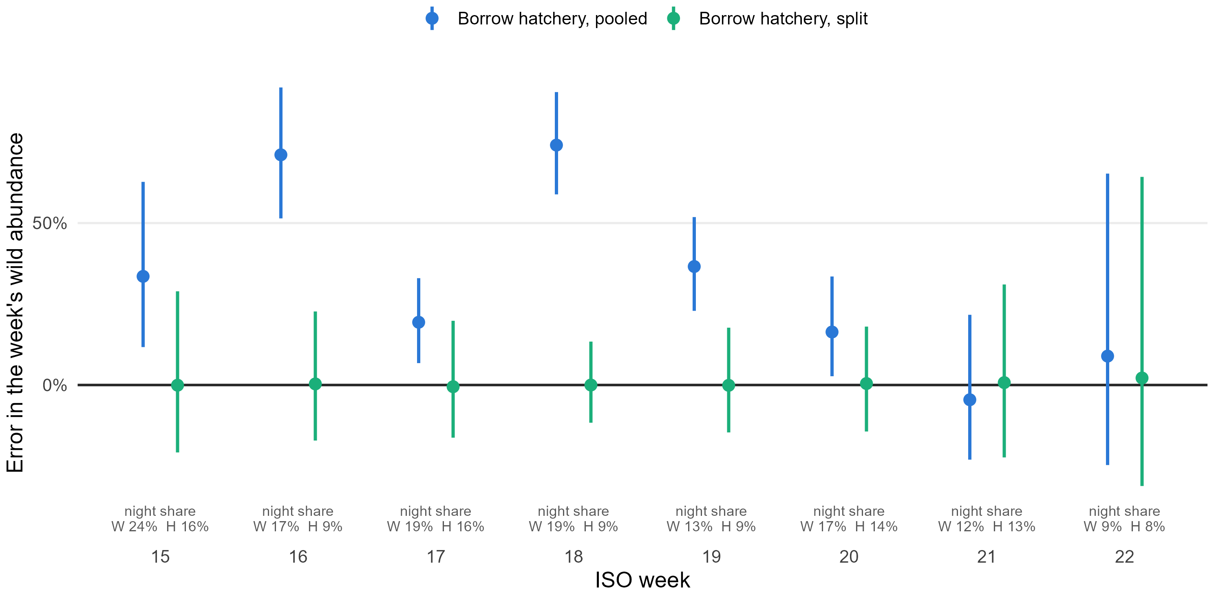
What Splitting Buys: A Simulation With Known Truth
PART 4 · DAY AND NIGHT
2,000 simulated seasons on MY2025 steelhead weeks 15 to 22. Wild and hatchery share the same true day GE, night GE, GRS detection, and Little Goose recovery; only their night shares differ. Wild borrows its GE from hatchery.
Borrow hatchery's pooled GE
+33%
Median error, season's wild total
90% of seasons: +26% to +43%
Split, then blend
+1%
Borrow day and night GE, then blend with wild's own night share
90% of seasons: -7% to +11%
Pooled misses are biggest in weeks 16 and 18, where wild fish pass at night about twice as often as hatchery fish.
Code: github.com/dsmi313/BSUecostats · 07_day_night.R (a smaller teaching version, not the 2,000-season simulation shown)
Notes:
Open with: "Remember slide 15: wild borrows from hatchery. Here's what happens if that borrowing ignores timing."
Setup: 2,000 simulated seasons built on MY2025 steelhead weeks 15 to 22. Wild and hatchery share the same true day GE, night GE, GRS detection, and Little Goose recovery. Only their night shares differ, as in the real data. Wild tag numbers match the real, thin wild weeks, and wild borrows its GE from hatchery.
Borrow hatchery's pooled GE: the season's wild total is off by a median +33% (90% of seasons +26% to +43%).
Borrow hatchery's day and night GE, blended with wild's own night share: median +1% (-7% to +11%).
The pooled misses are biggest in weeks 16 and 18, where wild fish pass at night about twice as often as hatchery fish (17% vs 9%, 19% vs 9%). In week 21, where night shares match (12% vs 13%), pooled does fine.
Say: splitting separates guidance from timing. That also shows the bypass works at night, cleans up the spill effect, and lets daily GE follow daily timing. Borrowing from hatchery is the one we can put a number on.
For Q&A: wild tags alone are nearly unbiased (median +2%) but wide (-10% to +22%). Borrowing with the split narrows that range by about 45% without adding bias. Script: day_night_split_sim.R.

Slide 21
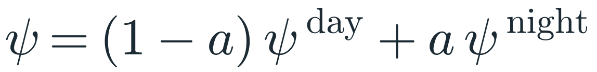
Splitting the Cells by Day and Night
PART 4 · DAY AND NIGHT
Day GE: the slide 17 regression
Night: a shift on top
Weekly GE: the blend (a = night share)
Day
c1
c2
c3
c4
c6
c5
pooled
# day: cells 1 to 5 (c1 c2 c3 c4 c6); night: 6 to 10; c5 pooled: 11
pi_raw[r,s,1] <- (1-a[r,s]) * psi_day[r,s] * (1-trans[r,s]) * (1-phi_B[r,s])
pi_raw[r,s,2] <- (1-a[r,s]) * psi_day[r,s] * (1-trans[r,s]) * phi_B[r,s]
pi_raw[r,s,3] <- (1-a[r,s]) * (1-psi_day[r,s]) * p[r,s] * (1-phi_S[r,s])
pi_raw[r,s,4] <- (1-a[r,s]) * (1-psi_day[r,s]) * p[r,s] * phi_S[r,s]
pi_raw[r,s,5] <- (1-a[r,s]) * psi_day[r,s] * trans[r,s]
pi_raw[r,s,6] <- a[r,s] * psi_night[r,s] * (1-trans[r,s]) * (1-phi_B[r,s])
pi_raw[r,s,7] <- a[r,s] * psi_night[r,s] * (1-trans[r,s]) * phi_B[r,s]
pi_raw[r,s,8] <- a[r,s] * (1-psi_night[r,s]) * p_night[r,s] * (1-phi_S[r,s])
pi_raw[r,s,9] <- a[r,s] * (1-psi_night[r,s]) * p_night[r,s] * phi_S[r,s]
pi_raw[r,s,10] <- a[r,s] * psi_night[r,s] * trans[r,s]
pi_raw[r,s,11] <- ((1-a[r,s]) * (1-psi_day[r,s]) * (1-p[r,s]) +
a[r,s] * (1-psi_night[r,s]) * (1-p_night[r,s])) * phi_S[r,s]
# condition on being detected
p_seen[r,s] <- sum(pi_raw[r,s,1:11])
for (cc in 1:11) { pi_obs[r,s,cc] <- pi_raw[r,s,cc] / p_seen[r,s] }
# each detected fish is one roll of an 11-sided die
n[r,s,1:11] ~ dmulti(pi_obs[r,s,1:11], N_seen[r,s])
Night
c1
c2
c3
c4
c6
A c5 fish was never seen at LGR, so nobody knows when it passed.
5 cells × 2 + 1 = 11 cells.
dmulti rolls an 11-sided die once per detected fish: pi_obs gives the chance of each face, and N_seen is the number of rolls.
Code: github.com/dsmi313/BSUecostats · 07_day_night.R (simplified: assumes p_night = p, equal GRS detection day and night)
Notes:
The slide 17 regression now applies to day GE: logit ψ_day[r,s] = μ_strat[g(s)] + rear_r + β spill + β_flow outflow + ε.
Night is a shift on top: logit ψ_night = logit ψ_day + night shift, and weekly GE is the blend ψ = (1 - a) ψ_day + a ψ_night.
Cells with an LGR detection have a passage time, so c1, c2, c3, c4, and c6 each split into day and night. A c5 fish was never seen at LGR, so nobody knows when it passed; it stays pooled. That's 11 cells.
Say (not on the slide): untestable assumption, GRS detection is the same day and night.
Likelihood panel: the 11 pi_raw lines, p_seen, and pi_obs are from fit_ge_rear_daynight.R (consistent structure); the file adds a tiny eps to each cell for numerical safety, left out here. The dmulti line is simplified from n[lik_r[j],lik_s[j],1:11] ~ dmulti(pi_obs[...], N_seen[...]), which loops only over rear-weeks with at least one detected fish.
Say: dmulti is rolling an 11-sided die. Each detected fish is one roll; pi_obs is the chance of each face, and N_seen is how many rolls. The observed counts n are how many times each face came up.
On the assumption: the code has p_night, but its offset (p_night_offset) defaults to 0, so night GRS detection equals day detection unless set otherwise; it's there for sensitivity runs.

Slide 22
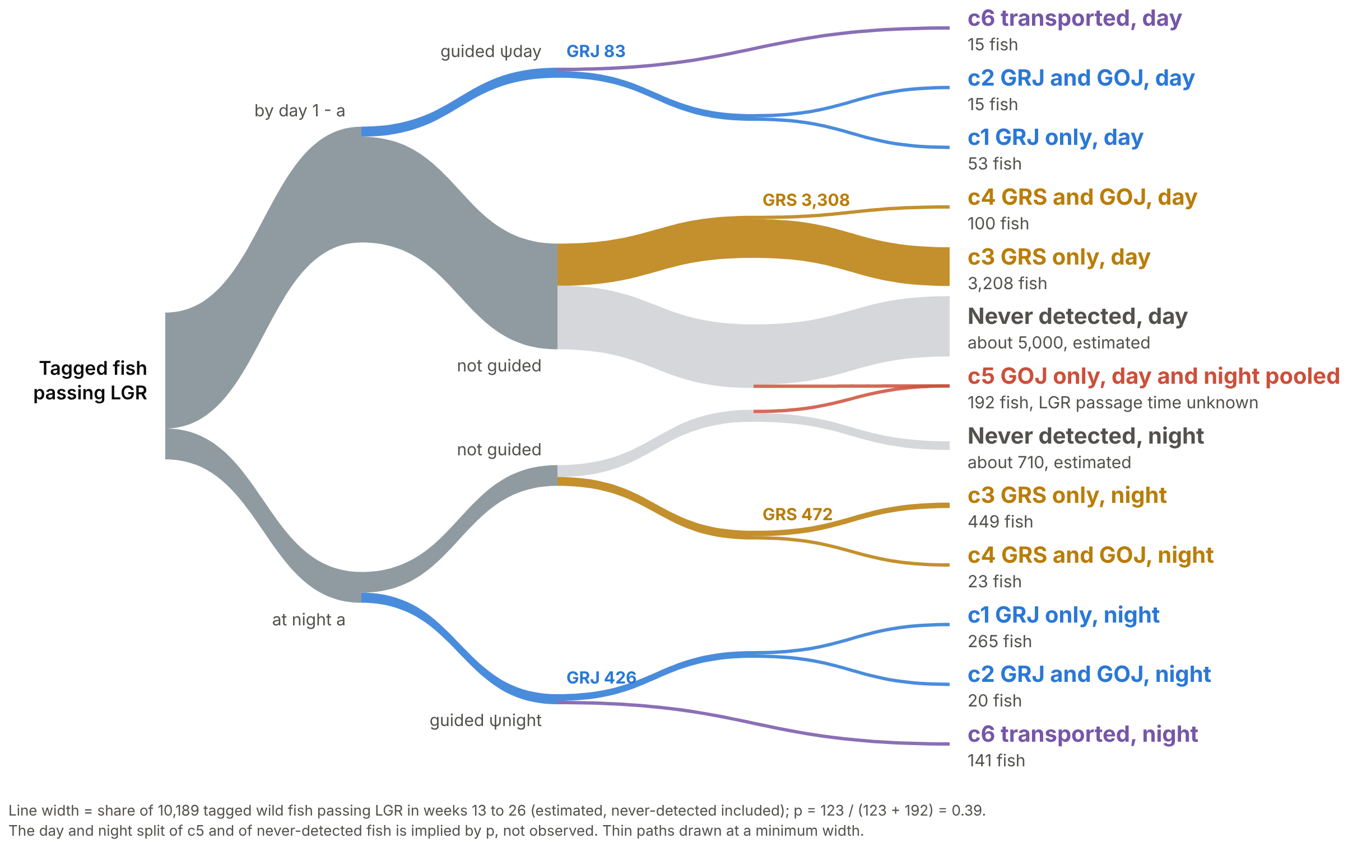
Every Detection History, One Picture
PART 4 · DAY AND NIGHT
Cell | Detected at | Probability
c1 day | GRJ only | (1-a) ψ_{d} (1-τ)(1-φ_{B})
c2 day | GRJ, GOJ | (1-a) ψ_{d} (1-τ) φ_{B}
c3 day | GRS only | (1-a)(1-ψ_{d}) p (1-φ_{S})
c4 day | GRS, GOJ | (1-a)(1-ψ_{d}) p φ_{S}
c6 day | Transported | (1-a) ψ_{d} τ
c1 night | GRJ only | a ψ_{n} (1-τ)(1-φ_{B})
c2 night | GRJ, GOJ | a ψ_{n} (1-τ) φ_{B}
c3 night | GRS only | a (1-ψ_{n}) p_{n} (1-φ_{S})
c4 night | GRS, GOJ | a (1-ψ_{n}) p_{n} φ_{S}
c6 night | Transported | a ψ_{n} τ
c5 pooled | GOJ only | [(1-a)(1-ψ_{d})(1-p) + a(1-ψ_{n})(1-p_{n})] φ_{S}
Each cell's chance before conditioning on being detected; never-detected fish drop out (slide 11). τ = transported, a = night share, pn = night GRS detection.
Code: github.com/dsmi313/BSUecostats · 05_six_cell.R, 07_day_night.R
Notes:
The finished tree: arrive day or night, then guided or not; guided fish are transported (c6) or returned and seen or not at GOJ (c2, c1); nonguided fish are read at GRS or missed, then seen or not at GOJ (c4, c3, c5, never detected).
Line width = share of the 10,189 tagged wild fish estimated to pass LGR in weeks 13 to 26, never-detected included. Rebuilding the counts from the PTAGIS file gives the same 10,189 as the artifact.
Both c5 paths merge into one pooled leaf. The grey leaf never reaches the data, which is why the model divides by the chance of being detected at all.
Stages 1 to 3 (slides 8, 11, 12) use the same layout and colors. Keep the live artifact open for Q&A: https://claude.ai/artifact/QQoWNo76jzNZSWaqbb7ENK

Slide 23
Pipeline and Uncertainty
PART 5 · FROM GE TO ABUNDANCE
1
Detection histories
2
GE model in JAGS
3
Daily wild GE
4
SCRAPI2
PTAGIS, sorted into 11 cells
hierarchical, day and night
one series per posterior draw
trap expansion, wild split, stock
Three sources of uncertainty, carried through together
Trap-sample bootstrap
GE posterior draws
Genetic stock posterior draws
Weekly fit to daily GE
Passage-weighted spill and flow
Spill decayed over the previous 7 days (0.5)
Each day's own night share, pulled toward the week's (k = 25)
Calibrated to keep the weekly day and night targets
Notes:
Detection histories, then the GE model in JAGS, then daily wild GE per posterior draw, then SCRAPI2.
Three uncertainty sources carried through: trap-sample bootstrap, GE posterior draws, genetic stock posterior draws (smoltEASE README).
Weekly fit to daily GE in one line each: passage-weighted spill and flow, spill decayed over the previous 7 days (0.5), each day's own night share pulled toward the week's with k = 25, and calibration that keeps the weekly day and night targets.

Slide 24
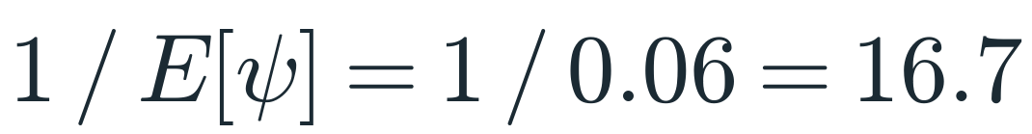
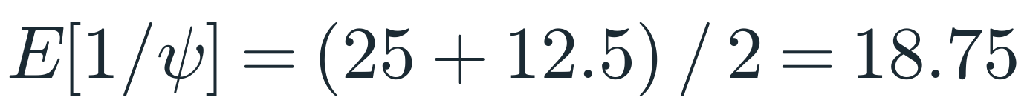
Jensen's Inequality Bit Us
PART 5 · FROM GE TO ABUNDANCE
Jensen’s inequality says that for a curved (convex) function, the average of the function is not the function of the average.
Two equally likely GE draws: 0.04 and 0.08. What's the expansion?
Average GE, then invert
Invert, then average
What early SCRAPI2 did
What it has to be, because SCRAPI expands by 1 / GE
What went wrong
Early SCRAPI2 used the first, and point estimates fell below their own bootstrap distribution. The gap grows as GE heads toward zero.
The fix
smoltEASE, September 2026: each bootstrap replicate carries its own GE draw, and the estimate is the mean of the replicates, so E[1/ψ] is built in.
Still open
Near-zero GE in a high-volume week, where the 1/GE tail is real. SCRAPI2 flags these weeks, and the results get a thorough review before estimates are finalized.
Code: github.com/dsmi313/BSUecostats · 02_lincoln_petersen.R, section 3; 08_bootstrap.R
Notes:
Two equally likely GE draws, 0.04 and 0.08. 1/E[ψ] = 1/0.06 = 16.7, but E[1/ψ] = (25 + 12.5)/2 = 18.75.
Early SCRAPI2 used the first, and point estimates fell below their own bootstrap distribution. It has to be the second, and the gap grows as GE heads toward zero.
The fix (smoltEASE, September 2026): every bootstrap replicate carries its own GE draw, and the estimate is the mean of the replicates, so E[1/ψ] is built in.
What's still open: when GE is near zero in a high-volume week, the 1/GE tail is real. SCRAPI2 flags these weeks, and the results get a thorough review before estimates are finalized.

Slide 25

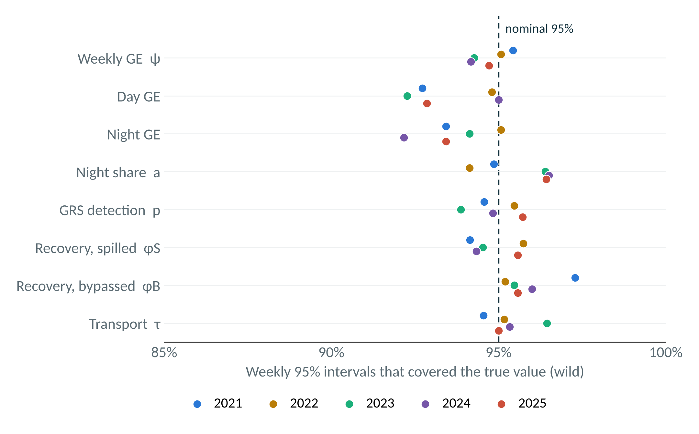
Does It Recover GE?
PART 5 · FROM GE TO ABUNDANCE
250 simulated seasons, 50 per year (MY2021 to 2025). Every wild parameter, every year: at least 92% of weekly 95% intervals covered the truth.
“Truth is known, so we know what to expect from the analysis.”
≥ 92%
0.014 to 0.029
≤ 0.009
92 to 95%
Kéry and Schaub (2012), Section 1.5. A primer for any ecologist fitting Bayesian models.
coverage for every wild parameter, every year
mean absolute error, weekly wild GE
mean error (bias), weekly wild GE
day and night GE: may run slightly narrow
Code: github.com/dsmi313/BSUecostats · 09_recover_truth.R (a teaching version on the six-cell model, not the multiyear validation shown)
Notes:
Kéry and Schaub (2012) is a primer for any ecologist fitting Bayesian models, and simulated data run through the whole book. Their reason (Section 1.5): "Truth is known, so we know what to expect from the analysis." Simulate from known truth, fit, compare.
250 simulated seasons: 50 per year, MY2021 to 2025, each drawing its own true parameters around that year's real fit (v13 recovery simulation, rear model).
The figure: for each wild parameter and year, the share of weekly 95% intervals that covered the true value. Every wild parameter, every year, is at or above 92%; weekly GE ψ is 94 to 95% every year.
Weekly wild GE accuracy: mean absolute error 0.014 to 0.029, mean error 0.001 to 0.009 (essentially unbiased).
Honest line: day and night GE run slightly under nominal (as low as 92.3% day in 2023, 92.2% night in 2024). Each dot is about 700 weekly intervals, so binomial noise alone is about plus or minus 0.8 points; weekly intervals within a seed aren't independent, so that's optimistic. Their intervals may run slightly narrow; with weeks correlated within a season, simulation noise can't be ruled out.
Day and night GE matter most here: they're what gets passed to the daily GE draws (each day's own night share), and weekly ψ is their blend.
What this test can't see: the simulated truth has daily variation from spill and flow, but not the unexplained day-to-day noise in the real data.
For Q&A, the SCRAPI2 abundance recovery (moved off the slide): truth there is SCRAPI2 run at the true GE. Wild total mean error +0.4% (SE 0.5); half the seasons within 4.4%; 90% of seasons between -12% and +14%. 90% intervals covered in 236 of 250 seasons. 247 of 250 fits passed R-hat < 1.01 and bulk ESS > 400.

Slide 26
Lessons for Your Own Models
PART 5 · FROM GE TO ABUNDANCE
JAGS does the heavy lifting. Free, open-source Bayesian MCMC: write the model, and JAGS samples the posterior.
1
Hierarchical models connect observations to the answer. Share information across groups and carry uncertainty through to abundance.
2
The logit link fits naturally with probability models. Add covariate and group effects while keeping probabilities between 0 and 1.
3
Know what your marked fish are. Tags applied after the decision, and incomplete transport flags, both moved GE a lot.
4
Validate against simulated truth, not against another model.
5
Notes:
JAGS does the heavy lifting: free, open-source Bayesian MCMC. You write the model, and JAGS samples the posterior.
Hierarchical models connect observations to the answer: wild borrows from hatchery through shared strata, slopes, and week-level variation, and the posterior draws carry GE uncertainty all the way to the abundance estimate (slides 15, 17, and 23).
The logit link fits naturally with probability models: rear offsets, the spill and flow slopes, and the night shift all add on the logit scale, and GE stays between 0 and 1 (slide 16).
Know what your marked fish are: tags applied after the decision, and incomplete transport flags, both moved GE a lot.
Validate against simulated truth, not against another model.
For Q&A (cut from the slide): identifiability lives in one cell. p rests on c5, and under high spill a fish missed at GRS likely spills again at Little Goose and never shows at GOJ, so c5 shrinks. Check with prior-posterior overlap and simulation (BPA 7.9). A random walk on logit GE wasn't identifiable with the nested structure (the intercept and the walk's first term were collinear and floated freely), so we kept iid weekly effects with nested shrinkage.
If asked how we know p is identified: BPA 7.9 separates intrinsic nonidentifiability ("a feature of a model") from extrinsic ("a feature of a data set"), and says the extrinsic kind "is best studied using simulation." In a Bayesian fit an unidentified parameter still gets a posterior; it just mirrors the prior, so check prior-posterior overlap (Gimenez et al. 2009b). Thin c5 under high spill is the extrinsic kind, and the recovery simulations on slide 25 are the check.
BPA 7.9 also notes that when year effects are random instead of fixed, "the problem of nonidentifiability disappears" because the full data set informs the poorly identified terms. That's part of the case for hierarchical weeks.

Slide 27
BPA Reading Map
PART 5 · FROM GE TO ABUNDANCE
Ch. 3
Generalized linear models and the logit link
In this talk: why GE lives on the logit scale (slide 16)
Ch. 4.1.4
Fixed vs random with few groups
In this talk: rear offsets (slide 15)
Ch. 5
State-space models
In this talk: IDFG's screw-trap estimator (slide 4)
Ch. 6
Closed-population capture-recapture
In this talk: Lincoln-Petersen and the row method (slides 4 and 9)
Ch. 7
CJS: 7.4 time variation, 7.6 time and group effects, 7.9 identifiability
In this talk: the GE regression (slide 17)
Kéry and Schaub (2012), Bayesian Population Analysis using WinBUGS
Ch. 9
Multistate models
In this talk: the LGR model (slides 11 to 22)
Code: github.com/dsmi313/BSUecostats · every script ends with the BPA sections it draws on
Notes:
Where to read more in Kéry and Schaub (2012):
Ch. 3: generalized linear models; 3.2.3 on link functions and 3.5 on the binomial GLM with the logit link.
Ch. 4.1.4: fixed vs random with few groups (rear offsets).
Ch. 5: state-space models (what IDFG now uses at screw traps).
Ch. 6: closed-population capture-recapture (Lincoln-Petersen's home, and the GRS row method).
Ch. 7: CJS, especially 7.4 and 7.6 (time and group effects) and 7.9 (identifiability).
Ch. 9: multistate models (the LGR model).

Slide 28
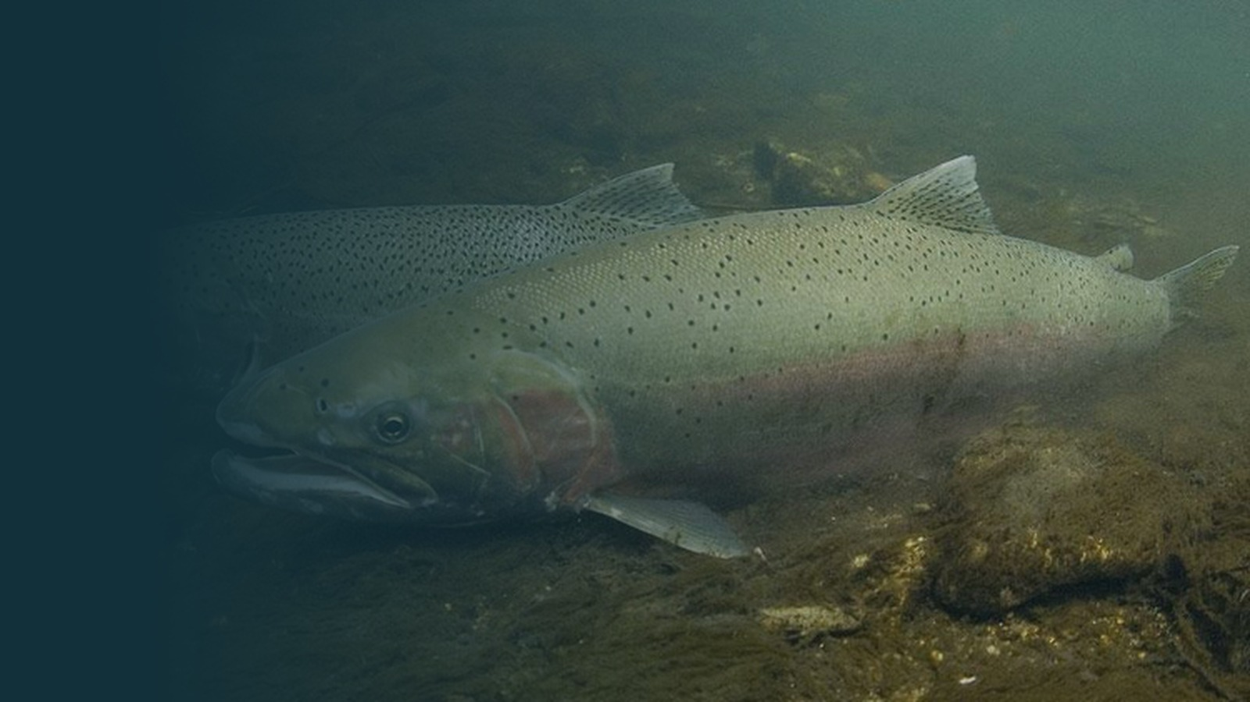

Thanks
Tim Copeland, Jonathan Ebel, and Luciano Chiaramonte
Questions?
Dave Smith
Idaho Department of Fish and Game, Nampa Research
david.smith@idfg.idaho.gov
Code for this talk
github.com/dsmi313/BSUecostats
Notes:
Check before presenting: confirm the thanks list (Tim Copeland, Jonathan Ebel, Luciano Chiaramonte, others). VERIFY: photo credit for the steelhead photo.

